Slide 1


WP6: Smart Information Flow along the Supply Chain
Lukas Nagel
Dr. Florian Maurer
Dornbirn, 12.12.2023

Slide 2

Content
WP6 – tasks and activities: events
WP6 – task and activities: learning material
Open tasks
Notes:
SC AUSTRIA LUSTENAU ☺

Slide 3
WP6 – tasks and activities: Events (1)
The main result of this work package is the lecturing and supervision of students (and lecturers) in their investigation into the digital transformation and digitization in the field of supply chain management/supply chain networks.
1) Classic-traditional instruments (i.e., lecturing, teaching, …)
2) Hands-on instruments (i.e., excursion, summer school, games, …)
3) “Generation Z” instruments (i.e., lunch2grow, pitches, market places, …)

Slide 4
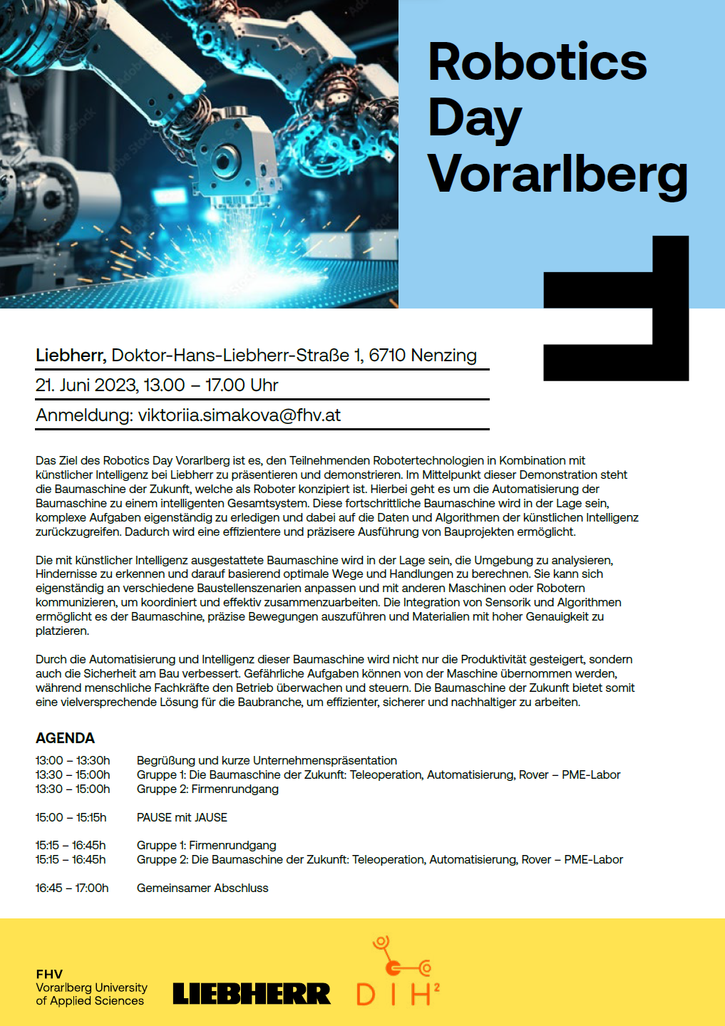
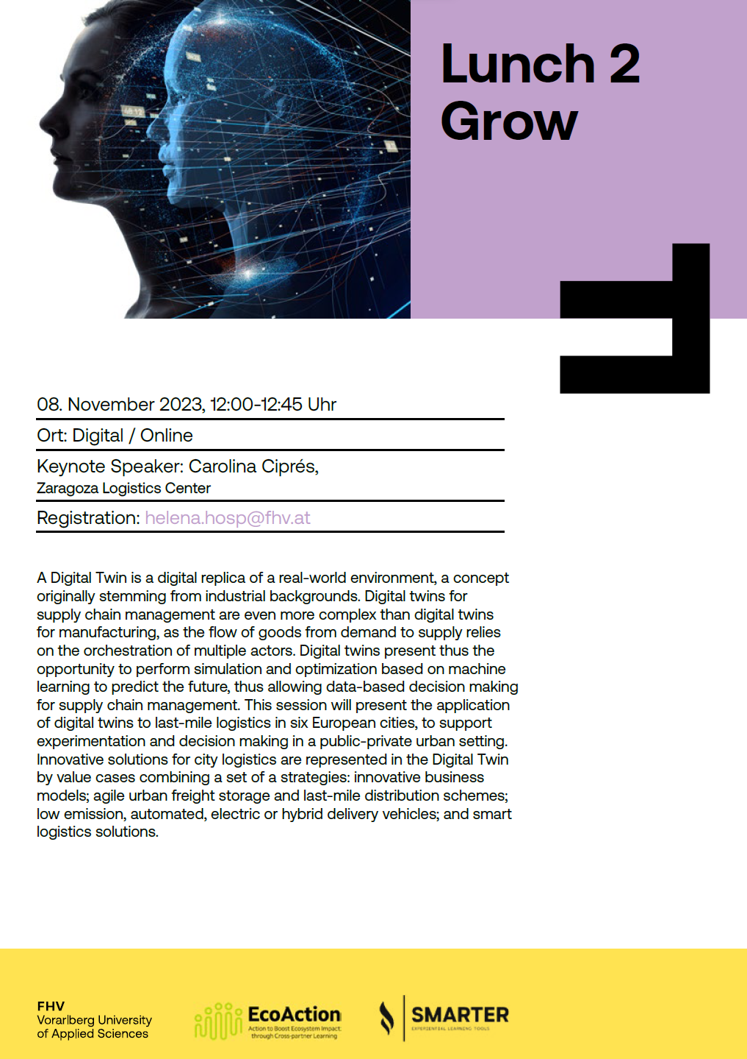
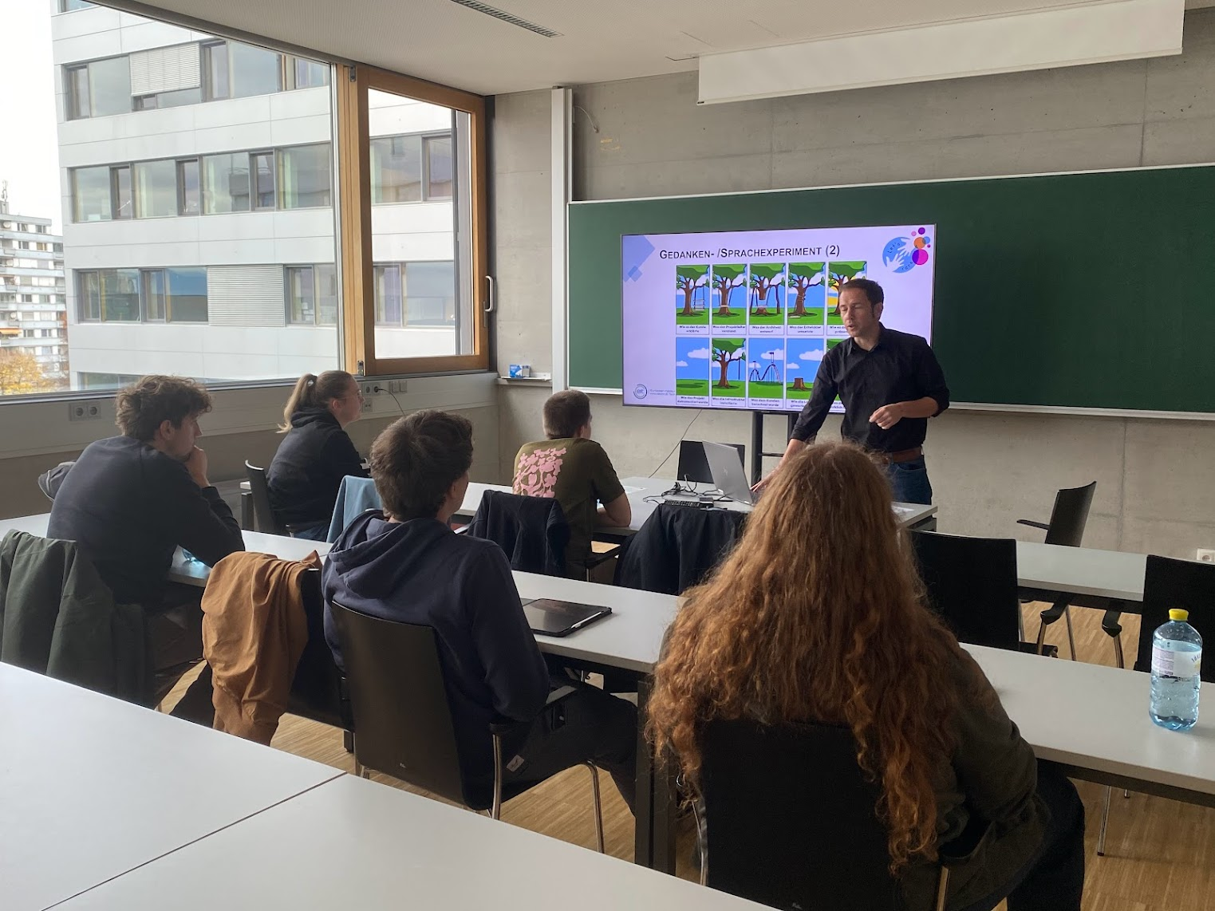
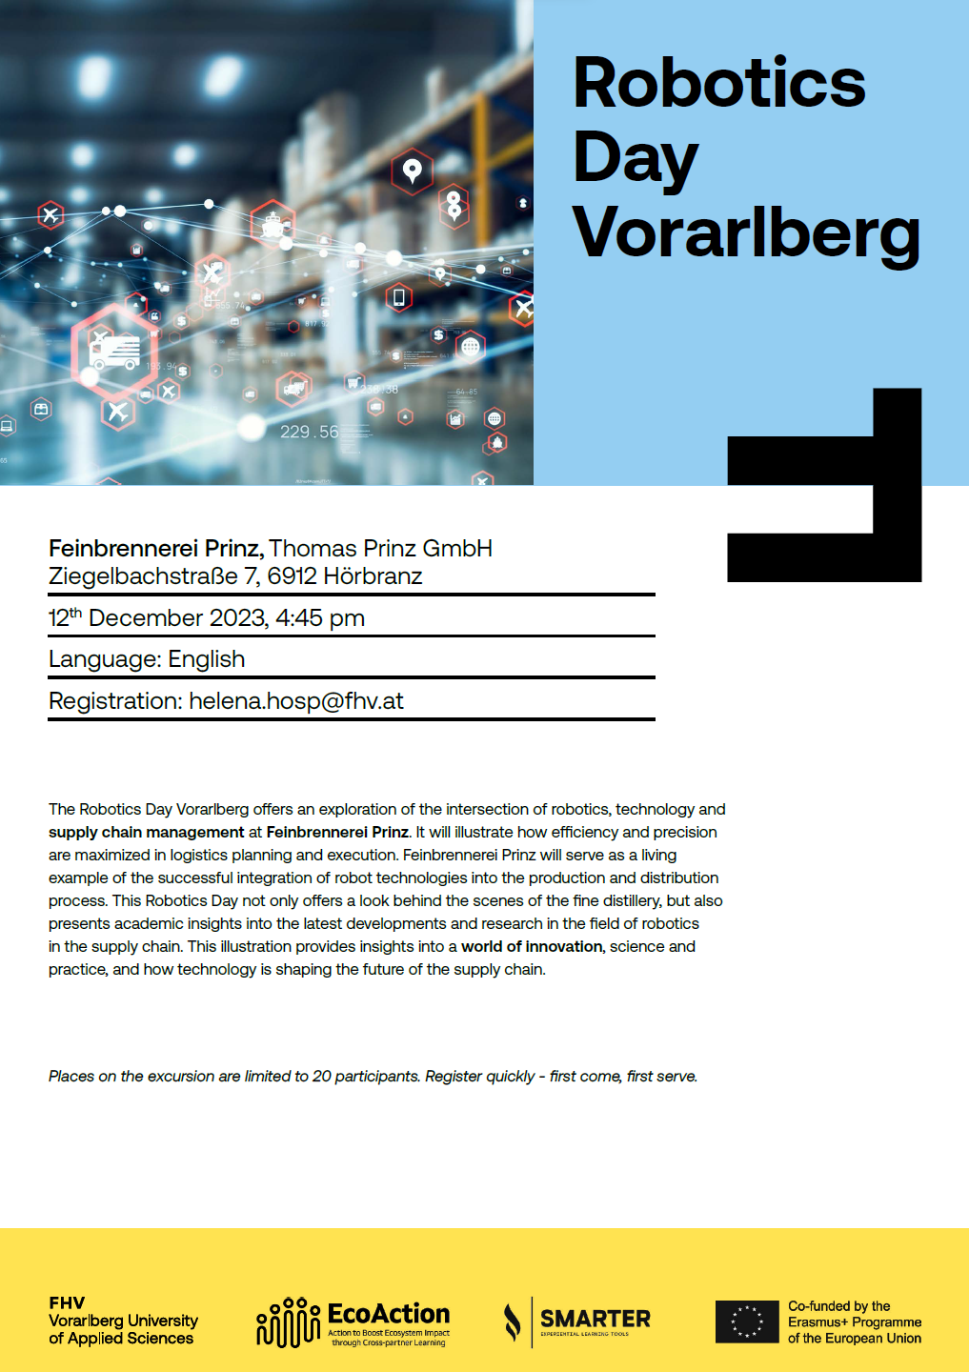
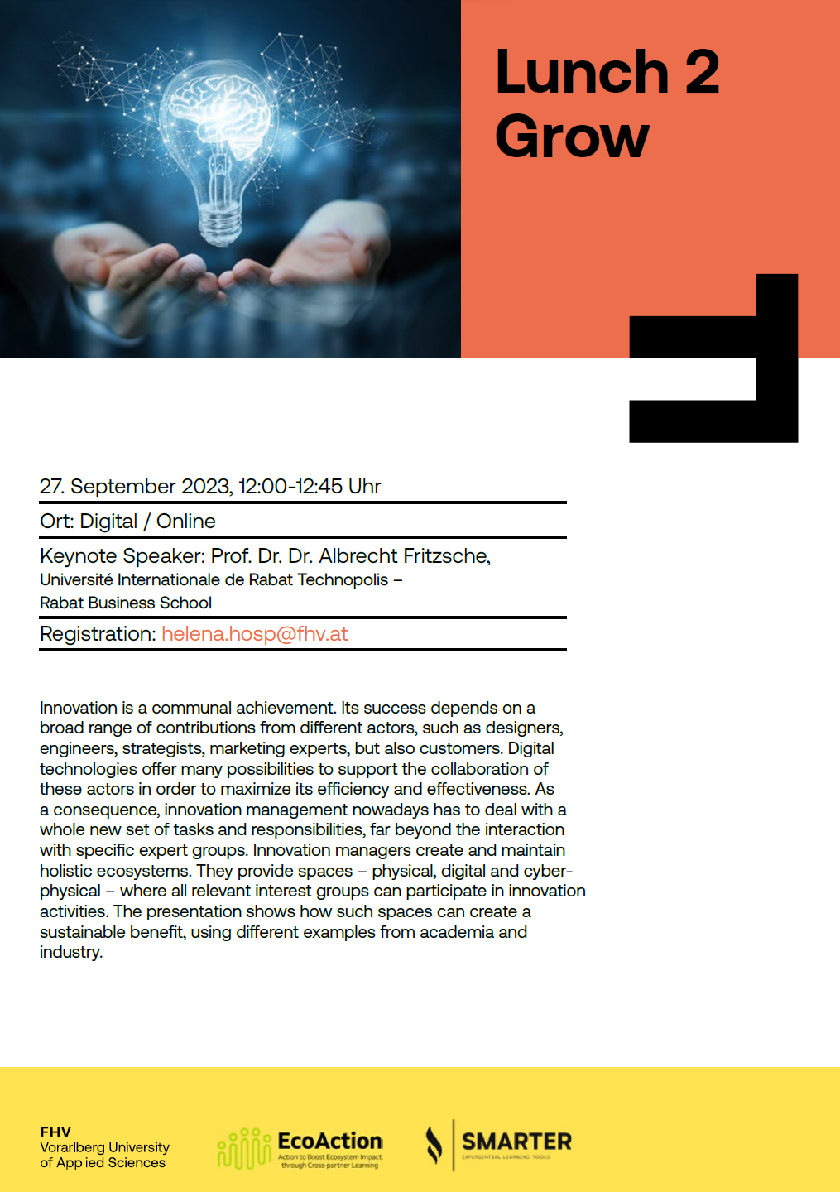
WP6 – tasks and activities: Events (2)
Robotic Day Vorarlberg
Lunch2Grow
Lectures
2+1 out of 12

Slide 5
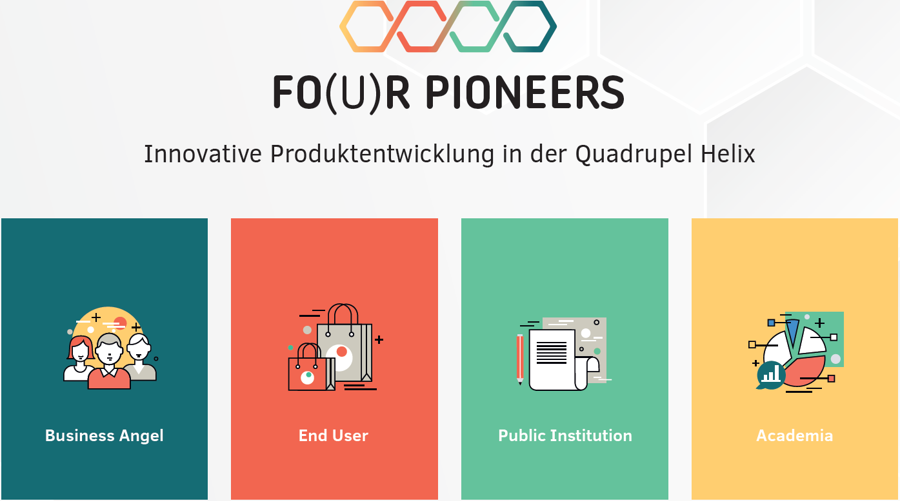
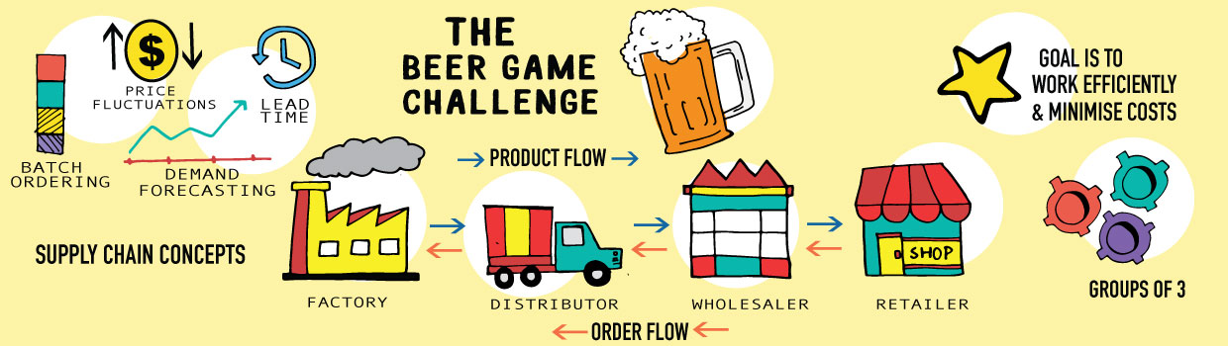
WP6 – tasks and activities: Events (3)
Fo(u)r Pioneers (FHV)
Beer Distribution Game
Is one of the oldest and most widely used management simulations. Participants learn about the structure and dynamics of supply chains, i.e., in operations management, supply chain management, economics, systems thinking, dynamic modeling, organizational behavior, leadership, and team building, and any course in which the dynamics of cooperation and interpersonal interactions are relevant.
Fo(u)r Pioneers is a serious gaming board game for up to four teams of two to five Players + one moderator. Each team develops a product idea under the aspects and exciting questions of the Quadruple Helix. Product development is divided into three phases: planning, development and implementation.

Slide 6
WP6 – tasks and activities: Learning Material (1)
WP 6 will deliver learning material, learning environment best practices, conduct manuals for educational events like summer school 2024, confluence learning events between industry and university and documentation of collaborative learning in an international context.
1) Analysis: Logistics & Supply Chain Market*
2) Development of Information Systems
2) MRP1-, MRP2- and ERP-Systems
3) Advanced Planning and Scheduling System (APS)
4) IT provider analysis (SAP, Oracle, … Transflow/LBase**)
5) Student report: experience with Information Systems in Logistics & SCM
*IT provider perspective
**Key-note Lunch2Grow (?)

Slide 7
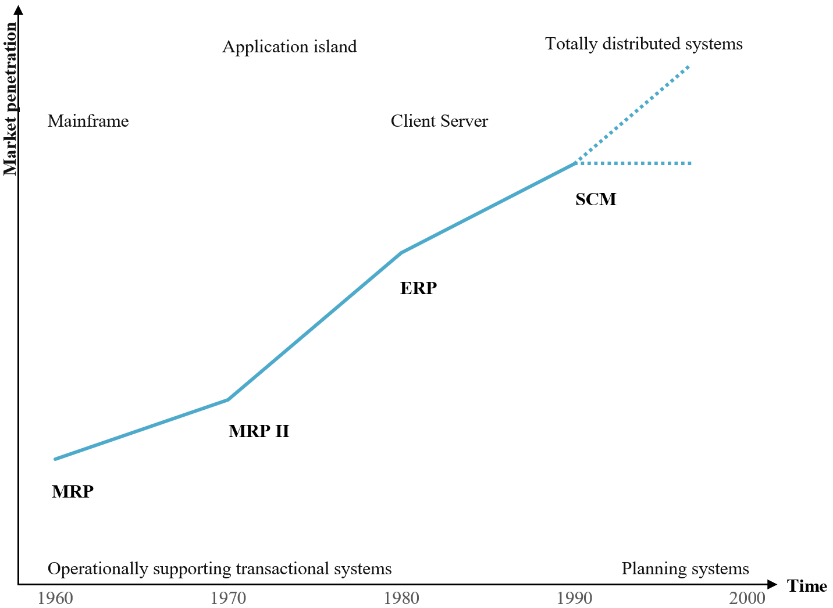
Development OF INFORMATION SYSTEMS
Over the course of time,
the functional scope of the systems continued to improve, sometimes less, sometimes more.
The newer system builds on the previous system and serves more as an improvement rather than a replacement.

Slide 8

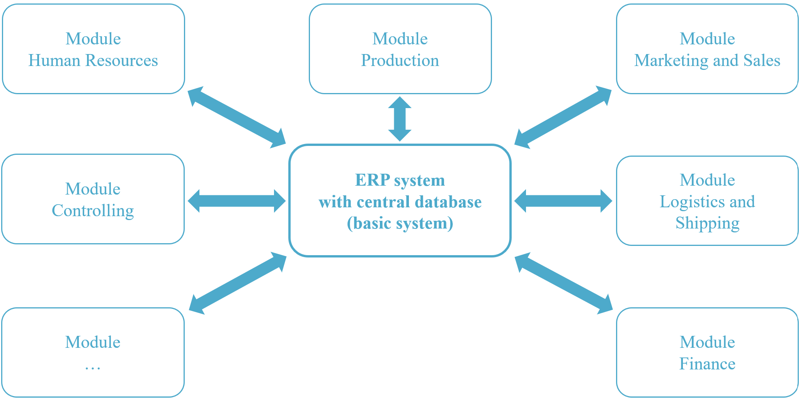
MRP1-, MRP2- and ERP-Systems
MRP – Material
Resource Planning
The system was used to calculate the materials and components required for high-volume standardized production.
Each department had its own database, so the same data was recorded multiple times by different departments separately.
MRP2 - Manufacturing Resource Planning
MRP2 plans include all resources required for production, such as workers, equipment, and machines.
Furthermore, capacity planning checks whether the plan is feasible. MRP2 integrates a single unified database that pertains only to production and its closely involved departments.
ERP – Enterprise
Resource Planning
All departments within the company can access the information in the ERP database, which is expandable with modules for specific requirements.

Slide 9
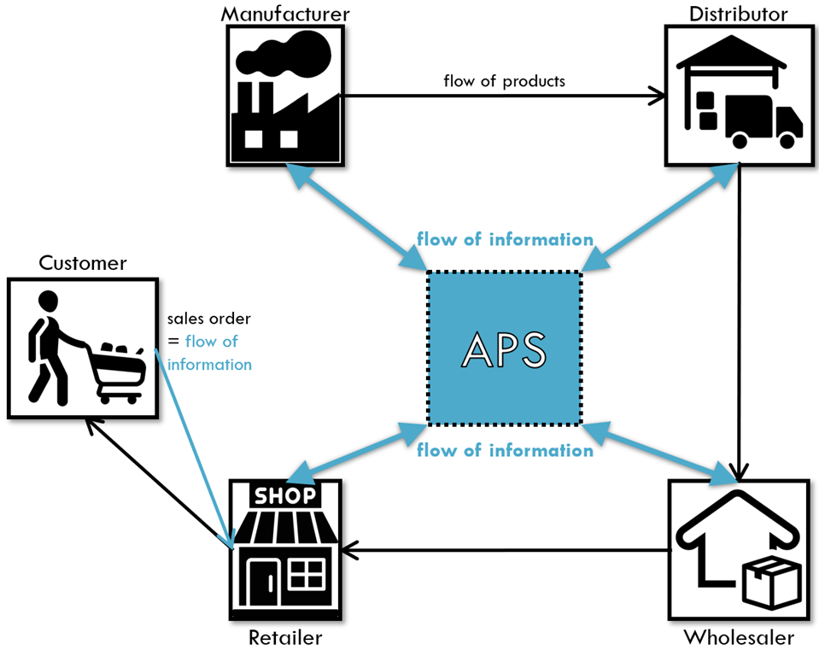
Advanced Planning and Scheduling System (APS)
APS supports cross-location and cross-company planning, control, and monitoring of value-added processes.
It enables all participants to gain detailed insight into the information flows of the entire supply chain in real-time,
see graph attached.
+ Benefits:
simultaneously considering and simulating relevant planning variables
elevating customer service
streamline delivery times
curtail costs
optimize inventory
and many more …

Slide 10



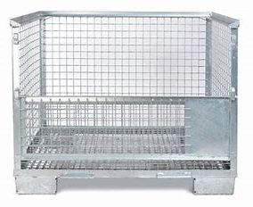
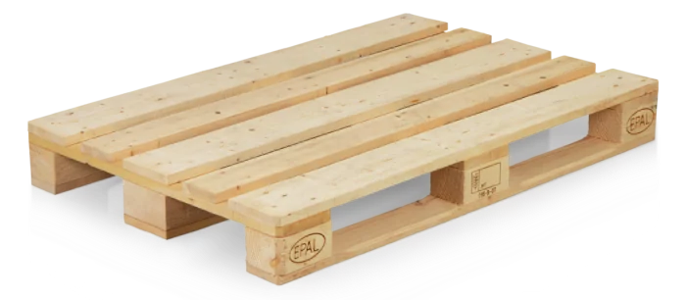

Experience with Information Systems
My work experience:
4 years by the international transport and logistics company Gebrüder Weiss
managing loading equipment
prices rose significantly, during COVID-19 pandemic
Systems in Use:
CIEL:
like a databank
stores shipments and their documents
stores the key-ids of all business partners
OPAL:
booking system for pallets- and grid boxes- accounts
SAP:
creates invoices and credit notes
Ways of Communication:
Within the Department:
verbal
Cross Department:
input in Ciel and intern calls less verbal and emails
With other Companies:
email and phone calls

Slide 11
WP6 – Open Tasks: Quantitative indicators
1) Online webinars – target value: 12 (2+1 achieved)
  Planning and organization of excursion(s) [FHV], [NDHub], [KUAS], [PCUVa], [UNL]
  Co-organization of meetings and workshops in a “fancy” format (e.g. lunch2grow, info breakfast meeting) [FHV]
2) 25 lecturers participating in the webinars
3) 10 bachelor and/or master thesis supported
  Supervision of semester works, Bachelor- and Master Thesis, [FHV], [SAMK], [UVa], [ITC], [KUAS], [UNL], UTBv]
  Webinars and online lectures at a partner institution [FHV], [SAMK], [UVa], [ITC], [KUAS], [UNL] [UTBv]
4) Summer school
  Co-organization of the Summer School 2024, [SAMK], [ITC], [FHV], [UVa]
  Planning of common lectures [FHV], [SAMK], [ITC], [UVa], [UNL]
  Organization of a “Beer distribution game” event (during the Summer School 2024) [FHV]
  Co-organization of student competitions & advanced formats (e.g. hackathons) [ITC], [FHV], [SAMK], [KUAS], [UNL], [UTBv]

Slide 12
Thank YOU FOR YOUR ATTENTION
ANY QUESTIONS?
Understanding the Dynamics

