Slide 1

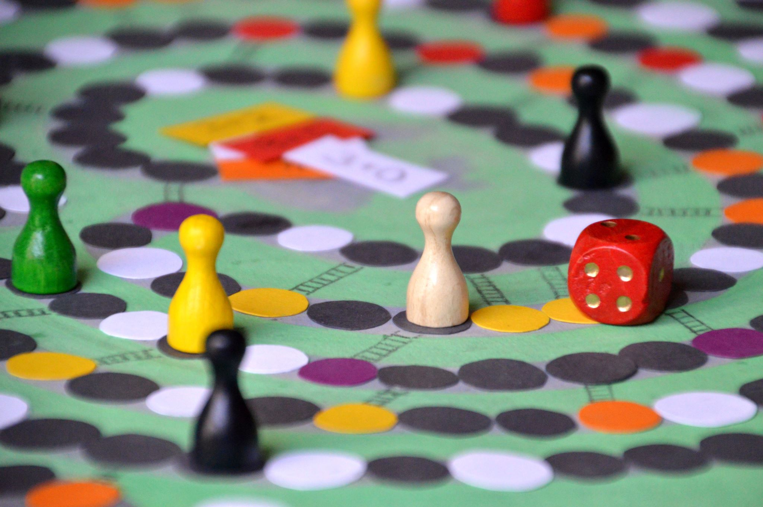


Beer Distribution Game
(Management Simulation)
2nd and 3th of September 24, SETU, Haughton Building
Dr. Florian Maurer, Shahin Manafi Varkiani PhD and Lukas Nagel

Slide 2

Introduction
The game board represents a 4-stage supply chain;
the production, transport, warehousing, and
distribution of beer
Management simulation game with
a two-day information gap of orders
and a two-day distribution gap of goods (raw material and beer)

Slide 3


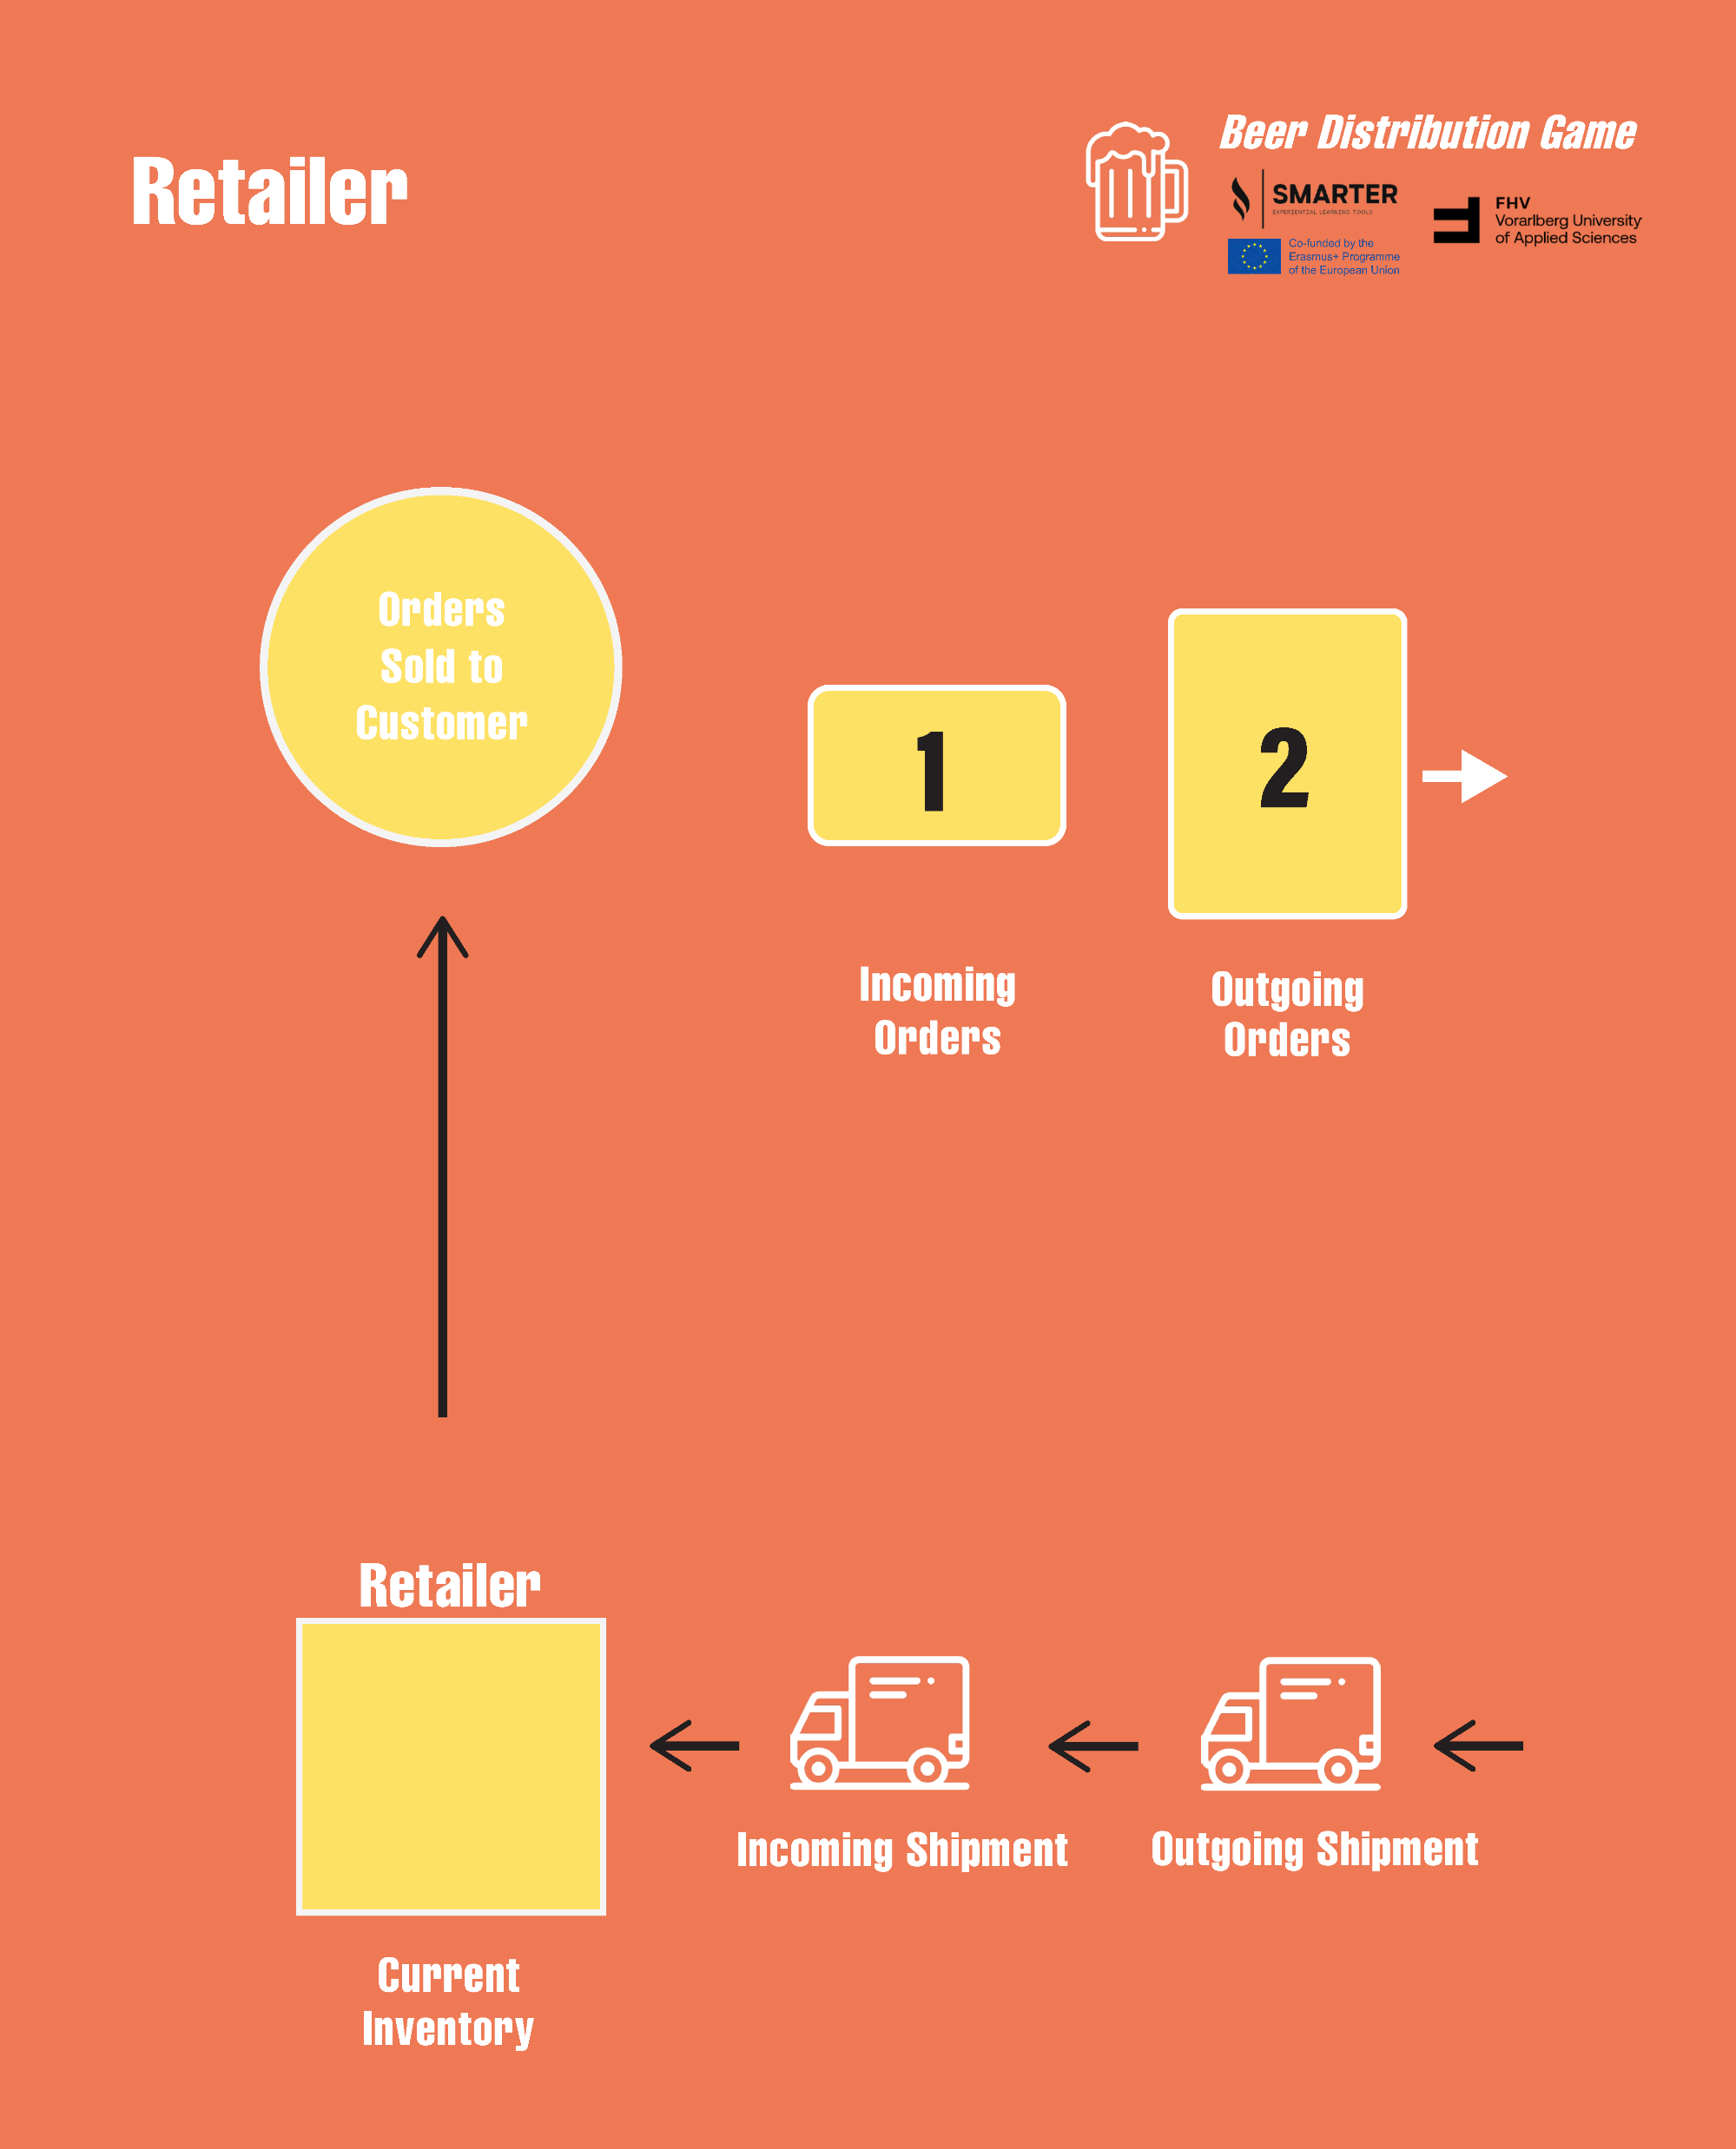
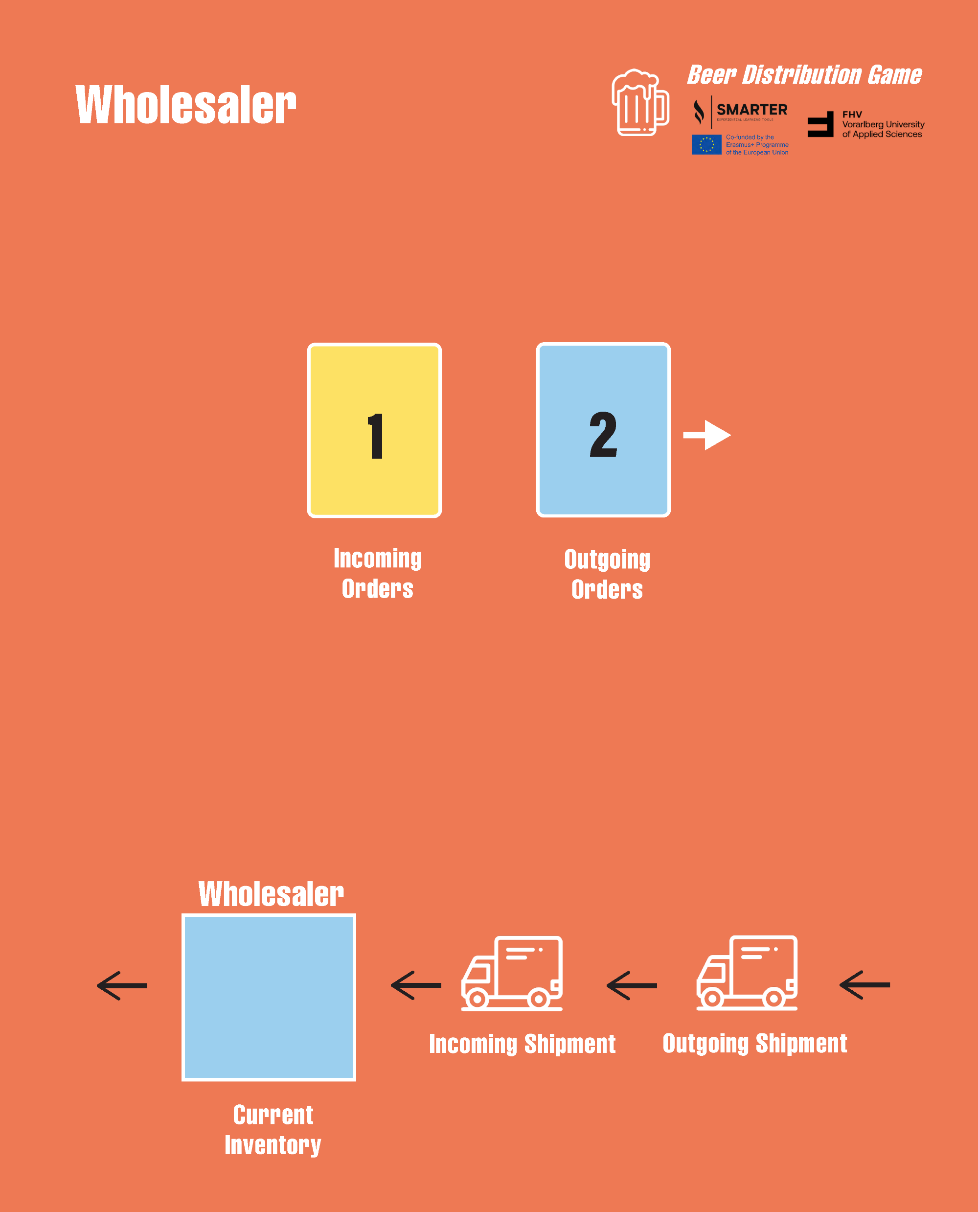
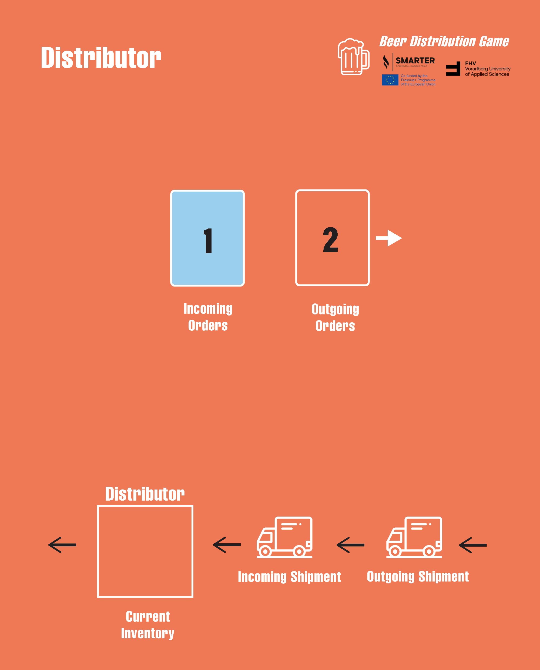
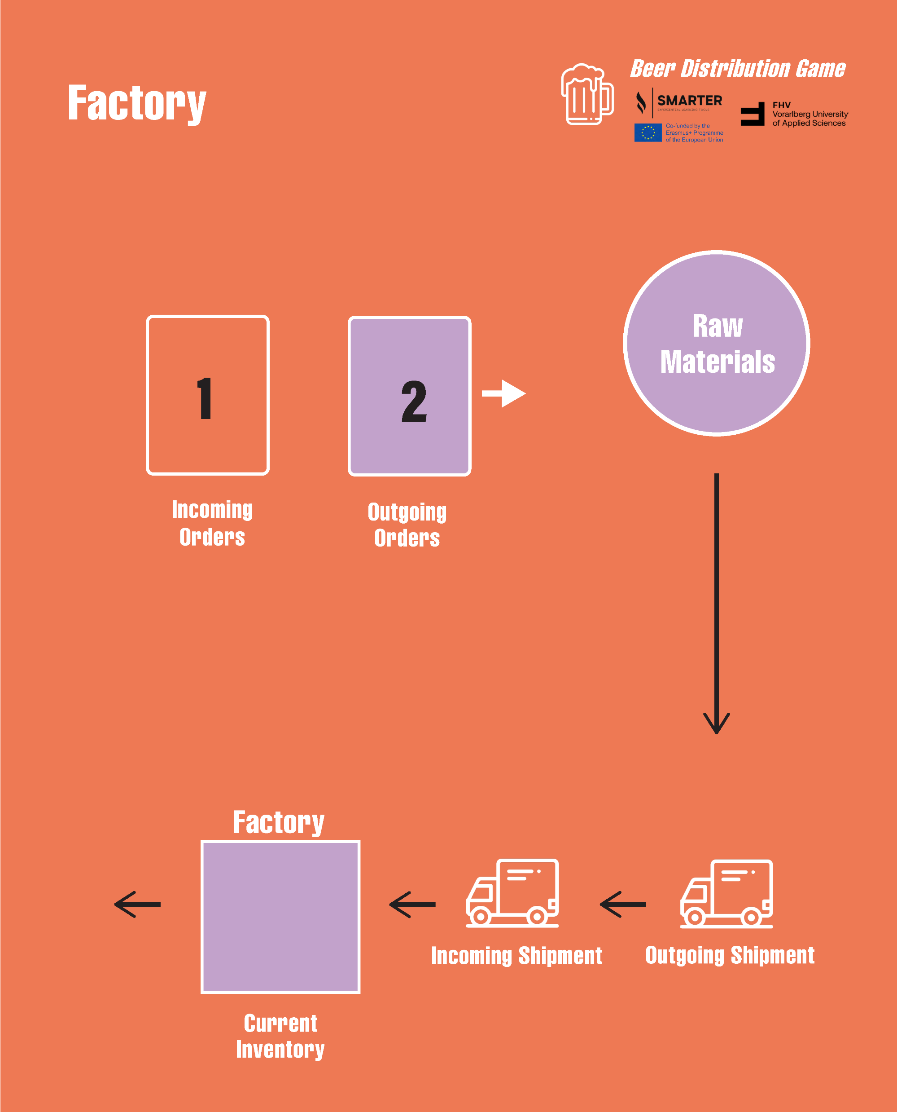







Four stages (stakeholders) in the supply chain
Flow of production (beer)
(Raw Material -) Factory -> Retailer (- Customer)
Flow of information (orders)
(Customer -) Retailer -> Factory (- Raw Material)
Retailer
Wholesaler
Distributor
Factory

Slide 4
Rules
A team is composed of 3-4 managers representing the retailer, wholesaler, distributor, or factory
Communication with the other teams is not allowed!
The first 15 min are for the introduction of the beer game:
getting familiar, test, questions, etc.

Slide 5

Goal
Efficiency and minimum costs:
Please supply the beer as efficiently as possible while minimizing costs (for warehousing: 1EUR = inventory per good, 2EUR = backorder per good)
Possible Strategy:
Have as little inventory as possible,
but do not run out of service!

Slide 6
Steps in each day (= round)
Duration: 50 rounds, each round symbolises a day
A day/round is composed of: the …
Morning: Logistics and transportation: inventory and goods
Afternoon: Warehousing: check incoming orders, dispose the shipment
Evening: Administration: distribute the old order, write a new order card
Ongoing task: Reporting & financial controll

Slide 7










Morning: Logistics
Receive the inventory (Incoming Shipment -> Current Inventory = incoming goods)
Transportation (Outgoing Shipment -> Incoming Shipment)

Slide 8



Afternoon: Warehousing
Get the incoming order card
(Customer) -> Retailer -> Wholesaler -> Distributor -> Factory -> (Raw Material)
4
4
4
4

Slide 9
Afternoon: Warehousing
Provide the outgoing goods in the empty transport box and deliver
Also erase and return the drawn order card
4
4
4
4

Slide 10
Evening: Administration
Forward the already placed order to your supplier
(Customer) -> Retailer -> Wholesaler -> Distributor -> Factory -> (Raw Material)

Slide 11

Evening: Administration
Forward the already placed order to your supplier
(Customer) -> Retailer -> Wholesaler -> Distributor -> Factory -> (Raw Material)
4

Slide 12

Evening: Administration
Write your new order and place it on the outgoing order field
Complete the table

Slide 13
Reporting & financial controll (ongoing task)
 |  | morning |  | afternoon |  |  | evening
 | Day | Incoming goods (deliveries from Incoming shipment) | Available goods (previous inventory + incoming goods) | Incoming order (from …) | Goods to deliver (previous backorder + incoming order) | Outgoing goods (=goods to deliver, unless not enough available goods) | Backorder (goods to deliver - outgoing goods) | Inventory (available goods- outgoing goods) | New outgoing orders (to the …)
 | 0 | - | - | - | - | - | 0 | 12 | -
start -> | 1 | 4 | 12 + 4 = 16 | 4 | 0 + 4 = 4 | 4 | 4 – 4 = 0 | 16 – 4 = 12 | individual
 | 2
 | 3
 | 4
 | 5
 | 6
 | 7
 | 8
 | 9
 | 10
 | 11
 | 12
 | 13
Your decision:
Between 0 and ∞
start ->

Slide 14
Reporting & financial controll (ongoing task)
 |  | morning |  | afternoon |  |  | evening
 | Day | Incoming goods (deliveries from Incoming shipment) | Available goods (previous inventory + incoming goods) | Incoming order (from …) | Goods to deliver (previous backorder + incoming order) | Outgoing goods (=goods to deliver, unless not enough available goods) | Backorder (goods to deliver - outgoing goods) | Inventory (available goods- outgoing goods) | New outgoing orders (to the …)
 | 0 | - | - | - | - | - | 0 | 12 | -
start -> | 1 | 4 | 12 + 4 = 16 | 4 | 0 + 4 = 4 | 4 | 4 – 4 = 0 | 16 – 4 = 12 | individual
 | 2
 | 3
 | 4
 | 5
 | 6
 | 7
 | 8
 | 9
 | 10
 | 11
 | 12
 | 13
Your decision:
Between 0 and ∞
start ->

Slide 15


Have fun – elaborate a competitive advantage!
Contacts:
FHV – Vorarlberg University of Applied Sciences
Research Center Business Informatics
Hochschulstr. 1
6850 Dornbirn
Dr. Florian Maurer
Email: florian.maurer@fhv.at
Skype: flo.maurer
Shahin Manafi Varkiani PhD
Email: shahin.manafivarkiani@fhv.at
Lukas Nagel
Email: lukas.nagel@fhv.at
CHEERS

Slide 16
Further readings
CHEERS
What the Beer Game can teach us about hoarding toilet paper | MIT Sloan
The secrets of the system | MIT News | Massachusetts Institute of Technology
Opinion | How to Soften the Bullwhip Effect - The New York Times (nytimes.com)

