Slide 1


Module 6b: Smart Information Flow along the Supply Chain – Webx & I
[Name of the presenter]
[Date & Location]

Slide 2
Content
Definition and basics of the internet … and its interrelation with technology, services, and applications
Web X.0, Intranet and Extranet
Trends with Cloud Computing and Edge Computing

Slide 3
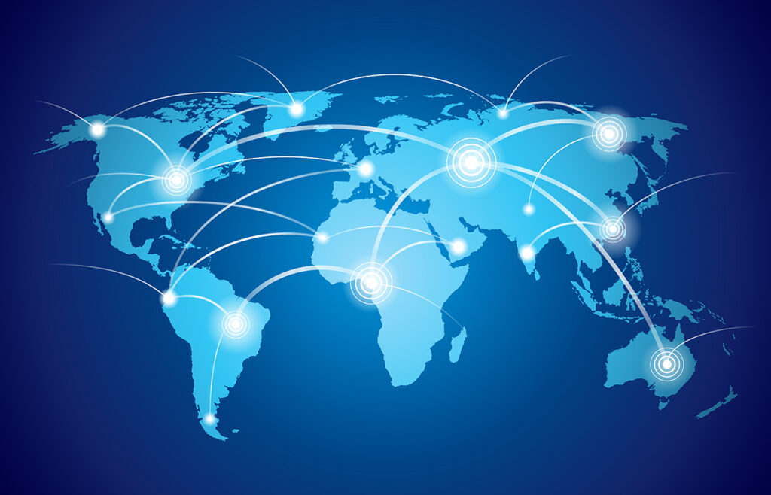
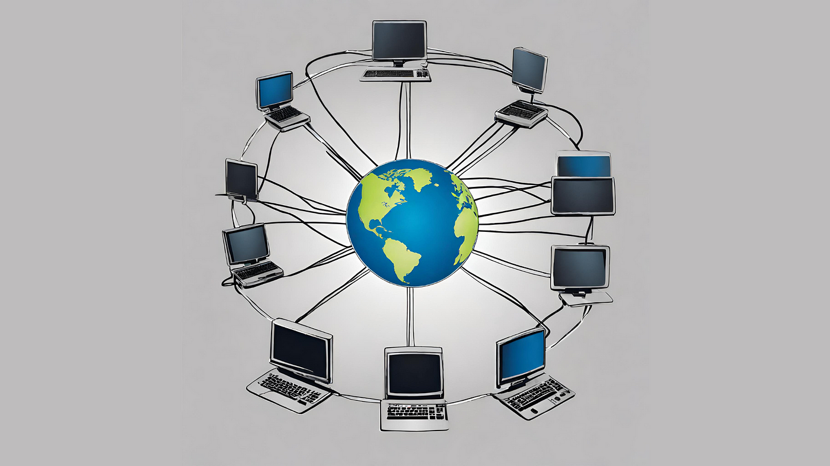
Internet
What is the internet?
A world wide system of interconnected networks and computers

Slide 4


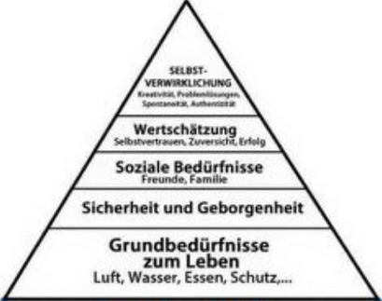



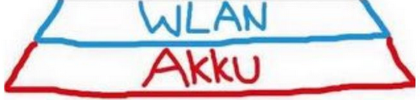
Internet as a basic/disruptive innovation for society and industry
*
Industry 1.0 → Mechanization
Industry 2.0 → Mass production, assembly lines
Industry 3.0 → Automatization, ICT, electronics
Industry 4.0*** → Cyber-physical systems, IOT, networks
Industry 5.0 Sustainability, Human Resources, Resilience
**
***
* Based on Maslow's pyramid of needs
** Please understand this graphic as a humorous interlude – the graphic has no scientific claim
*** Advanced Manufacturing (US)

Slide 5


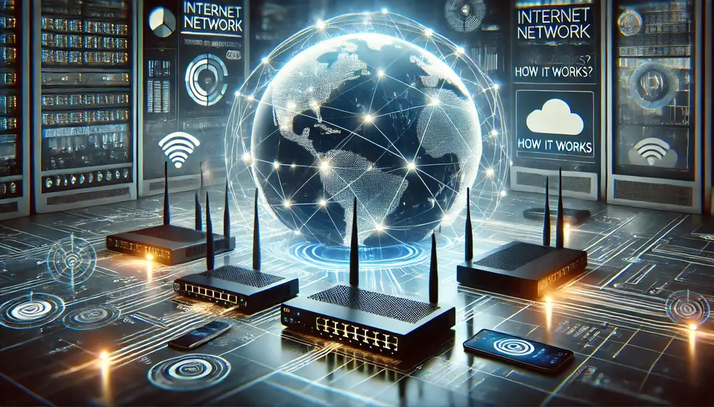
Short History
50‘ties: Network for military services (NASA/US Air Force – space technologies; Cold War: USA – UdSSR; 1957 Sputnik)
1969: ARPANET* – Prototype of the known internet today (4 Universities** interconnect); First Message: 29. Oct 1969: lo → Los Angeles – San Francisco
1971: E-Mail (first application - @ (2020: 300 Mrd E-Mails daily))
1983: TCP/IP – network protocol for secure communication btw. Server and client; universal and independet from operating systems; all thinkable connections (TCP divides into packages, IP forwards the packages to the recipient)
Until the 80ies: military interests are predominant → social and economic breakthrough: 1989 World Wide Web*** (WWW; laypersons can also access the internet)
1990/1991: Internet for commercial purposes
1993: First graphics-capable web brower, 1994: Web-applicatons like Yahoo, 1995: Amazon
* Advanced Research Projects Agency Network: Leitung MIT;
** Stanford, Utah, California LA, California Santa Barbara
* Main Innovator des Internets: Tim Berners-Lee, Software consult
CERN – Interconnection of Informationen

Slide 6
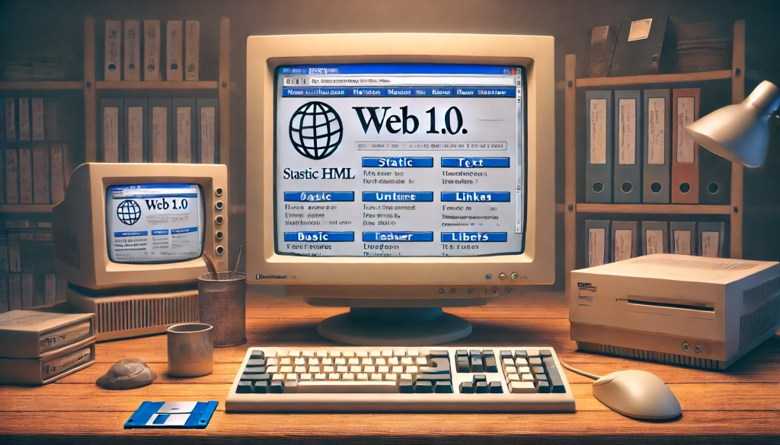
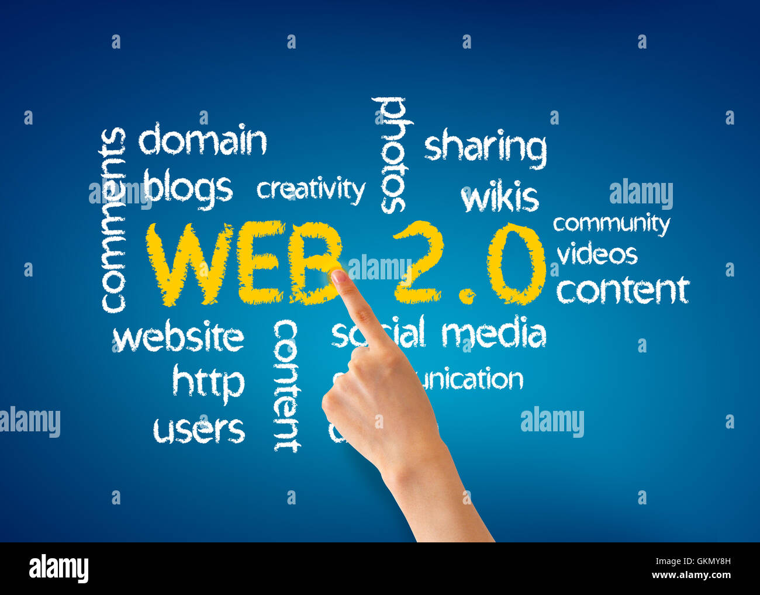
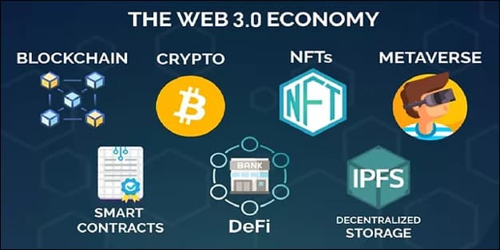
WEB X
Web 3.0: Semantic web*
Initial WWW
Semantic Web/Intelligent Web: Decentralization**, Utility, Interconnected and contextually online environment
User-tailored/personalized and interconnected Ecosystem
Web 2.0
Social Web: User-centric and user-generated content, all about the end user's experience; Dynamics, Interaction, and Usability for users
… the Internet most of us know today
Innovationen: Mobile Internet Access and Social Networks: FB, Twitter, YouTube, etc.
Web 1.0: The foundation
Static/Simply Web: Static website; Information repository, Online library; Real-time news and E-mail
t
1989 - 2005
1999 - 2012
2006 - ongoing
* Giant Global Graph, or Linked Open Data, oder: Web of Data
** Web 2.0: a total lack of data privacy, and far too much centralization; Web 2.0 companies act like a benevolent dictatorship

Slide 7
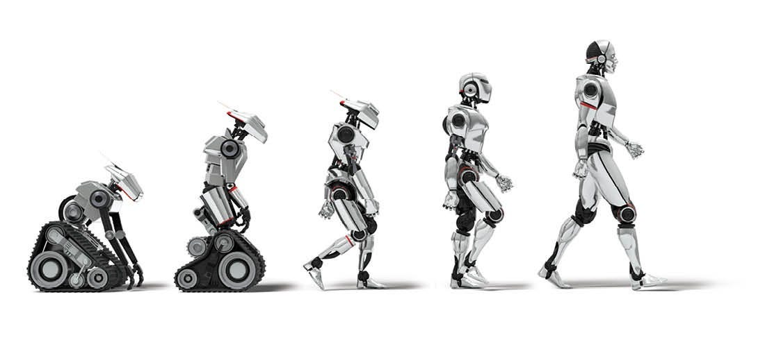

WEB X
Initial WWW
Web 5.0: Immersive* Web
Fully decentralized: intermediaries or governments cannot store or control a user’s data
Human-computer interaction: advanced social robots and embodied artificial intelligence
Artificial Intelligence
Web 4.0: Intelligent Web
Make the Internet more user-friendly, efficient, personalized, interactive, intelligent, and collaborative
Servitization: improved services and user experience
Web 3.0
* Virtual:

Slide 8
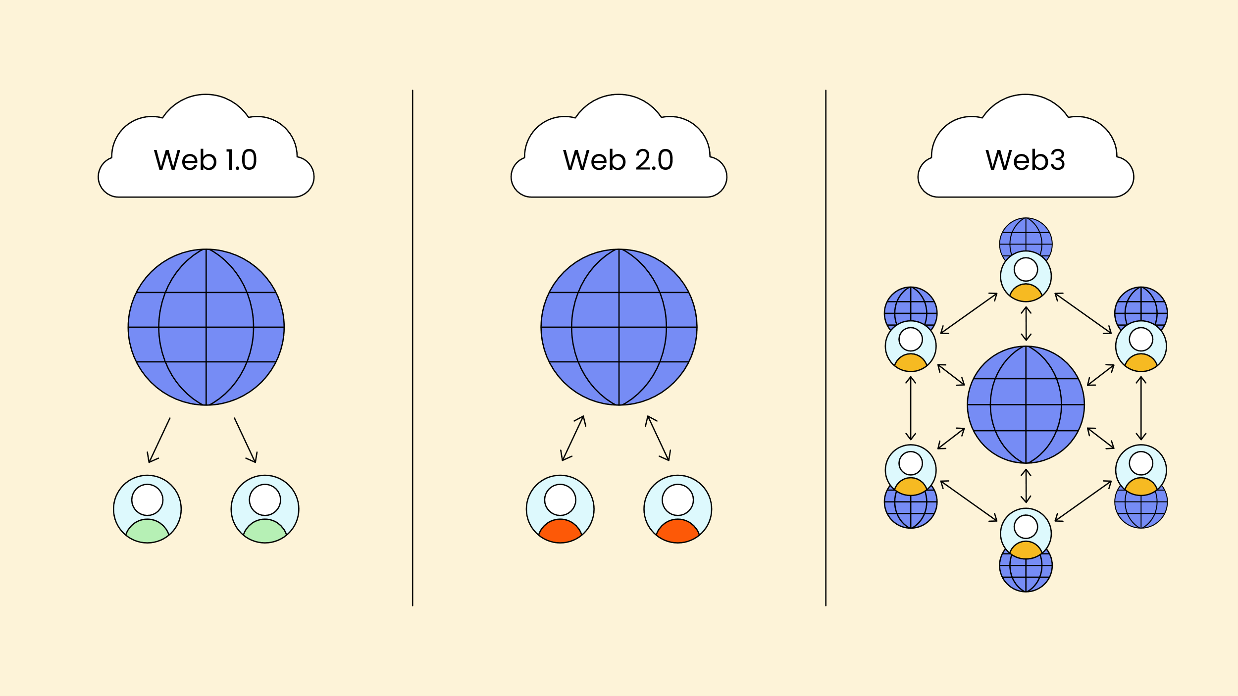
WEB X: Technologies
Web 3.0 (– 5.0)
Web 2.0
Web 1.0: the basis
Physical Machines → Virtual Machines → Cloud Infrastructure → Born in the Cloud
Technologies:
HTML – Hypertext markup language: determines the structure and content of a website
CSS – Cascading Style Sheets: defines the appearance and formatting of the website
JavaScript: enables the interactivity and dynamics of websites
HTTP(S) – Hypertext Transfer Protocol (secure): for secure communication on the Internet
TCP/IP

Slide 9
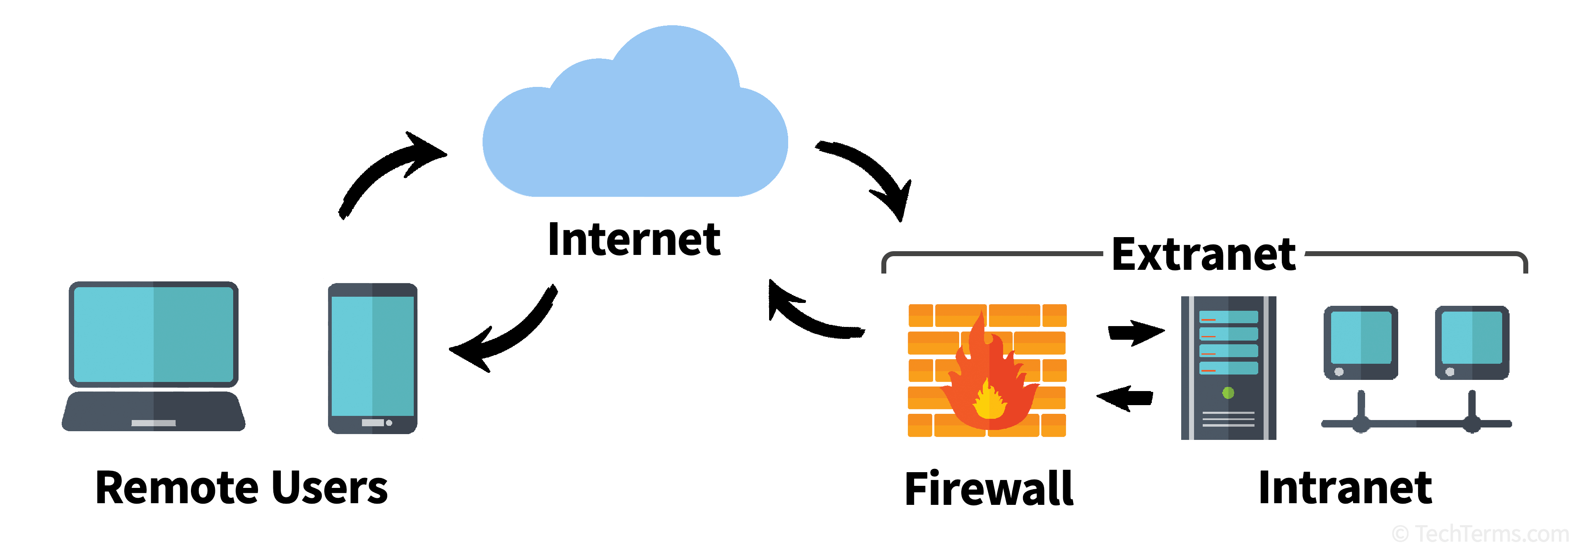
Internet
Mikä internet sinulla on?*
(Which internet do you have?)
*thanks to Deepl.com

Slide 10

Different forms
Internet
Clear Web (shopping, chat, share)
Deep Web (90% of the Internet; consists of (company) databases, websites and services (e.g. streaming, storage) that belong to companies, authorities or universities
Darknet (cannot be found in the conventional way; communication is encrypted and the authors of the content and its visitors or consumers want to remain as anonymous as possible)
Intranet
Company-internal communication network; based on the same network technology as the Internet
Is only accessible to a selected group of users (employees of a company)
Extranet
Independently secured private network to which only authorized users (partners, customers, suppliers) outside the company have access
Collaboration with external partners: to enable the exchange of data and applications and the sharing of information
Extranets lie somewhere between the Internet and intranet

Slide 11
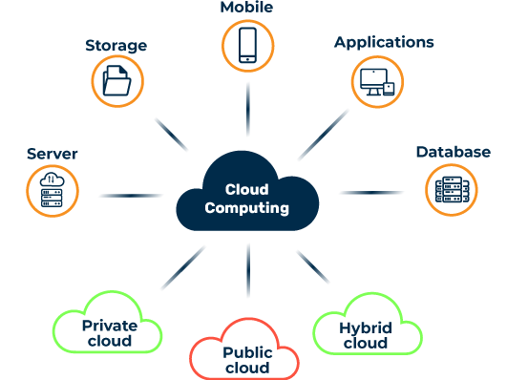
Cloud Computing
Provision of IT services via the Internet: Rent IT services instead of buying it
Dynamically offering, using and billing IT services via a network in line with demand
Access and store information without having to manage your own physical devices or IT infrastructure
Public clouds, private clouds and hybrid clouds
Examples?
Netflix, Google Docs, Spotify, iCloud backing

Slide 12
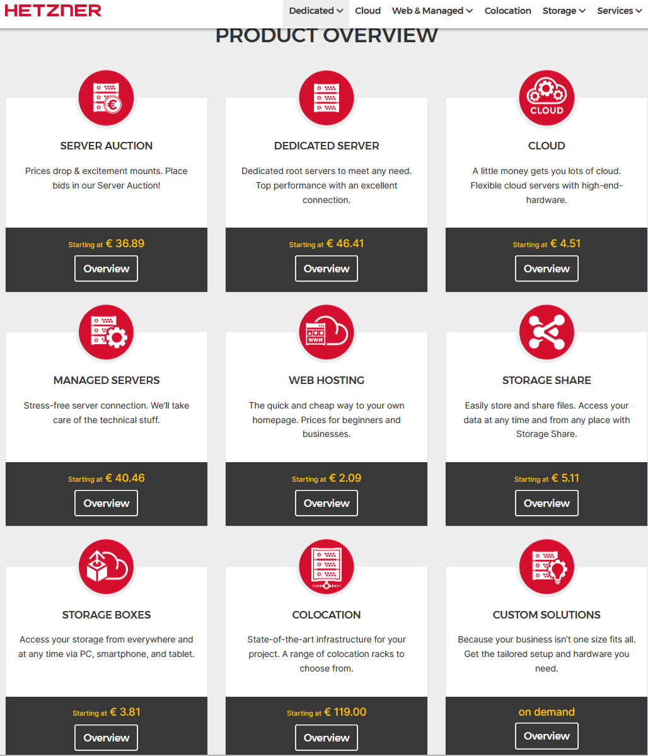
Cloud Services
Infrastructure as a Service (IaaS): renting a (virtual) machines (servers, computers), networks and storage space in a data center – accessible over the internet
Platform as a Service (PaaS): Developers have access to resources, such as Databases, Web Servers, Development Tools needed to create and run application software
Software as a Service (SaaS): pre-built software solutions for diverse tasks; utilizing software over the internet without the need for local installation (i.e., Games, CRM, E-Mail)

Slide 13
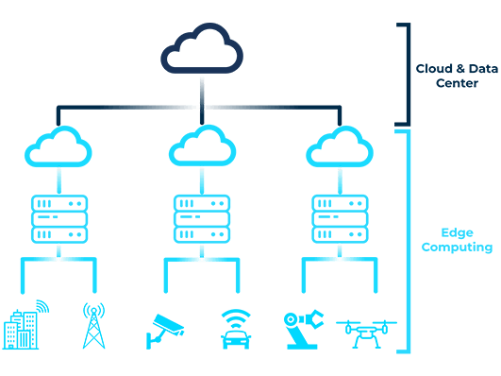
Edge Computing
Processing data close to where it is generated (instead of sending it to a central location for processing, as in cloud computing)
Edge devices are located at the boundary between digital processes and the physical environment and enable immediate and local data processing
Capture, process and analyze data at the furthest points of the network, e.g. examples ???
Factory robots, IoT, self-driving cars

Slide 14
Trends in Cloud- and Edge Computing
Cloud Computing
AI & ML - the “intelligent force” optimizing every aspect of cloud operations (AIaaS)
Generative AI - automatically generate and optimize code; make cloud services smarter
Superclouds
Hybrid and Multi-Cloud – mix of private and public clouds; multiple cloud services, like having accounts at different banks
Edge computing & 5G combinations
Sustainability - Data centers will become more environmentally friendly
Edge Computing
More devices will process data locally
Augmentation of Edge AI; will run directly on the devices instead of in the cloud
5G - high-speed, low-latency connectivity between edge devices and centralized systems - will make edge computing even faster
EaaS – access to processing power, storage, and networking resources located at the edge

Slide 15
Organization (to be Inserted)
Contact (to be inserted)

