Slide 1


Module 6a: Smart Information Flow along the Supply Chain – ICT
[Name of the presenter]
[Date & Location]

Slide 2
Agenda
Development of Information Systems
MRP1-, MRP2- and ERP-Systems (Internal Perspective)
Advanced Planning and Scheduling System (Orchestrating Perspective)
ECR, VMI (Integrative Perspective)
Digital Product Passport / Digital Material Passport

Slide 3
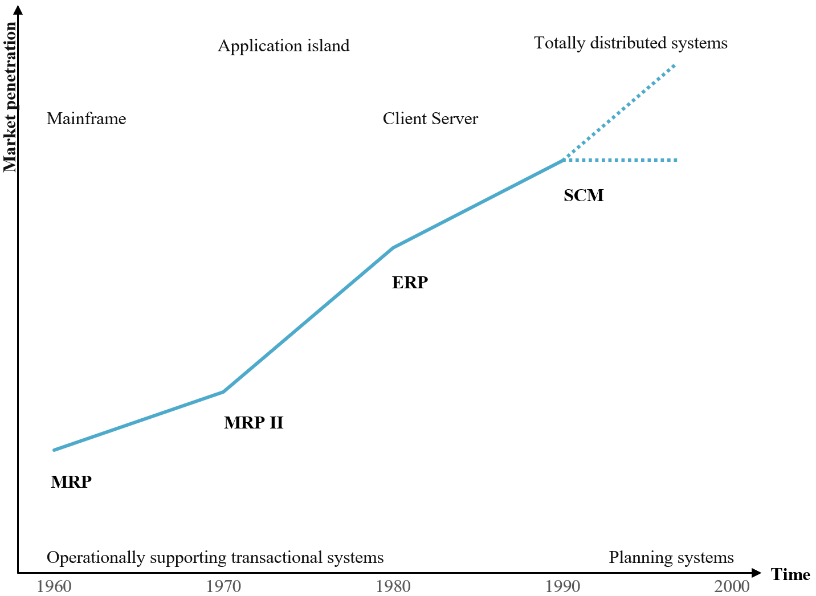
Development OF INFORMATION SYSTEMS
Over the course of time,
the functional scope of the systems continued to improve, sometimes less, sometimes more.
The newer system builds on the previous system and serves more as an improvement rather than a replacement.

Slide 4

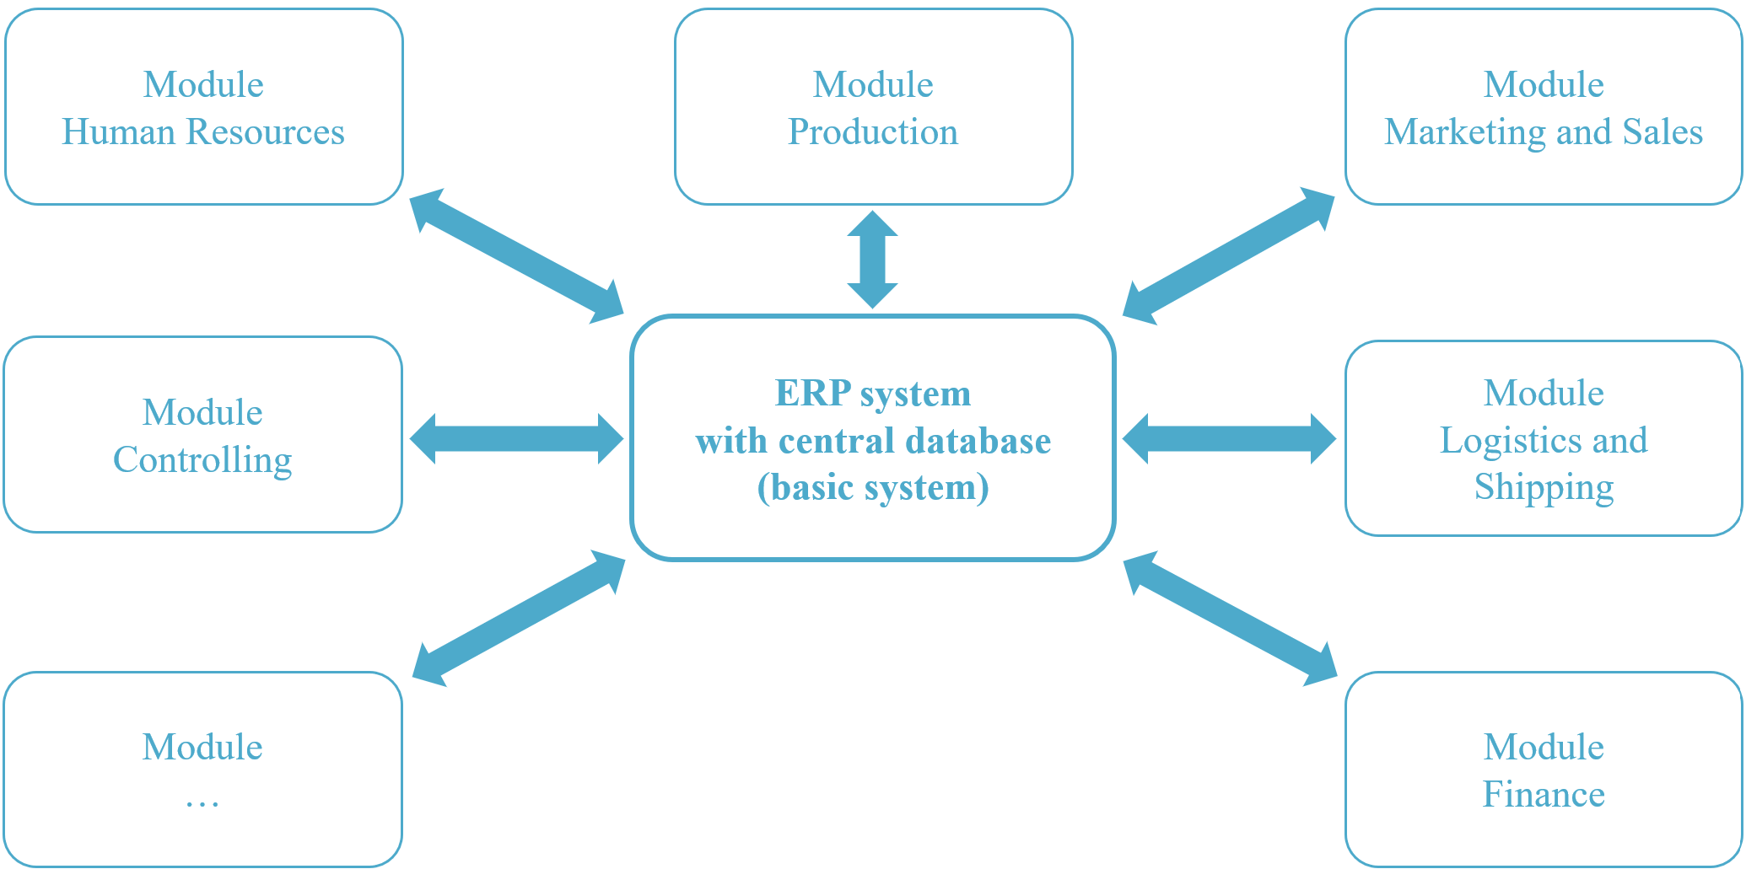
MRP1-, MRP2- and ERP-Systems (internal perspective)
MRP – Material
Resource Planning
The system was used to calculate the materials and components required for high-volume standardized production.
Each department had its own database, so the same data was recorded multiple times by different departments separately.
MRP2 - Manufacturing Resource Planning
MRP2 plans include all resources required for production, such as workers, equipment, and machines.
Furthermore, capacity planning checks whether the plan is feasible. MRP2 integrates a single unified database that pertains only to production and its closely involved departments.
ERP – Enterprise
Resource Planning
All departments within the company can access the information in the ERP database, which is expandable with modules for specific requirements.

Slide 5
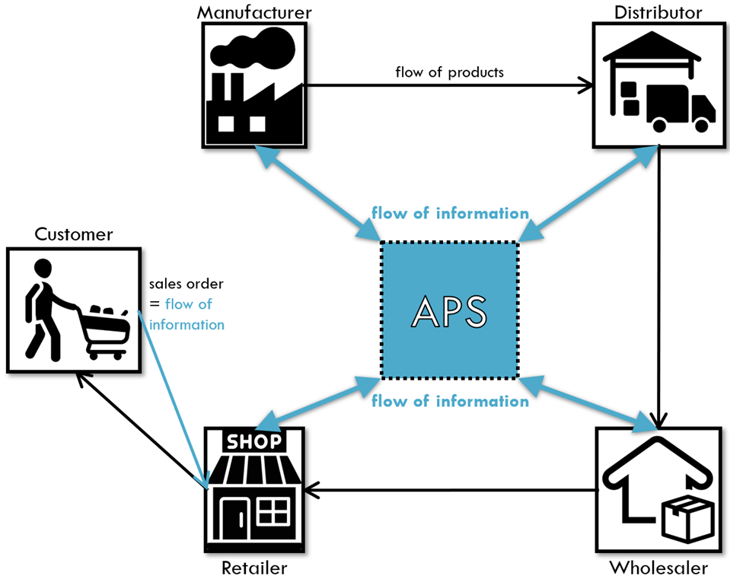
Advanced Planning and Scheduling System (Orchestrating Perspecitve)
APS supports cross-location and cross-company planning, control, and monitoring of value-added processes.
It enables all participants to gain detailed insight into the information flows of the entire supply chain in real-time,
see graph attached.
+ Benefits:
simultaneously considering and simulating relevant planning variables
elevating customer service
streamline delivery times
curtail costs
optimize inventory
and many more …

Slide 6
ECR, VMI (Integrative perspective)
ECR – Efficienct Consumer Response
Customer-oriented and holistic approach to the supply chain
Interorganizational cooperation between manufacturers, wholesalers and retailers
Integrated control of the entire supply chain
Venor Managed Inventory
Manufacturer takes over the disposition of the inventory in the customer's warehouse
Avoidance of duplicate safety stocks
Reduction of inventory costs and increase in service level
Disposition effort on the part of the retailer is eliminated
Reduction in freight costs

Slide 7
Digital Product Passport / Digital Material Passports
ECR – Efficienct Consumer Response
Customer-oriented and holistic approach to the supply chain
Interorganizational cooperation between manufacturers, wholesalers and retailers
Integrated control of the entire supply chain
Venor Managed Inventory
Manufacturer takes over the disposition of the inventory in the customer's warehouse
Avoidance of duplicate safety stocks
Reduction of inventory costs and increase in service level
Disposition effort on the part of the retailer is eliminated
Reduction in freight costs

Slide 8





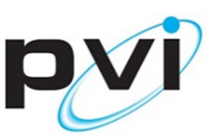










JIDEP Project Profile
JIDEP: Joint Integrated Data Exchange Pipeline
Program | Horizon Europe
Project Call | HORIZON-CL4-2021-RESILIENCE-01-26 - Sustainable Industry Commons (RIA)
Budget | 2.2 M EUR
Coordinator | FHV Vorarlberg University Applied Science
Partner Profile | 7 country-13 company&university
Use Cases
GA Number

Slide 9
Project Objectives
Data Reusability
Development of ontologies for enhanced exchange and result of industrial data
Use FAIR data priciples
Data reusability
Digital Tools
Develop tools for boosting the overall sustainability of diverse industries
Material passport for better understanding of material’s circular property
Secure collaborative space
Transformation
Increase autonomy and reinforce the resilience of European industries
Transform resources into valuable and non-substitutable resources
Platform Validation
Validate JIDEP tools and platform automotive,renewables and PCBs use cases
Collaborative Spaces
Build a collaborative ecosystem
Leverage data exchange across the entire value chain
Cross sectional circulat European value chains for the remanufacturing, reuse and recycling high added valur components

Slide 10
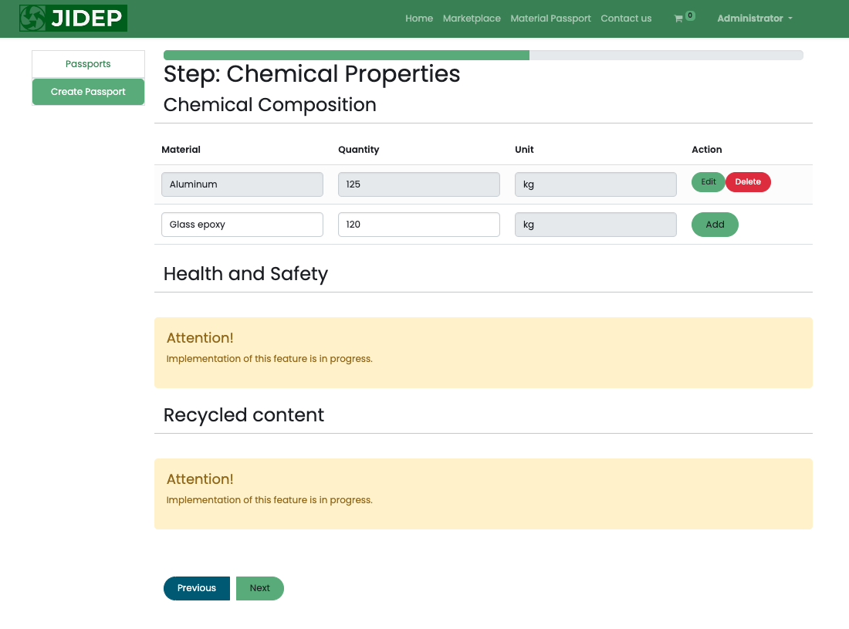
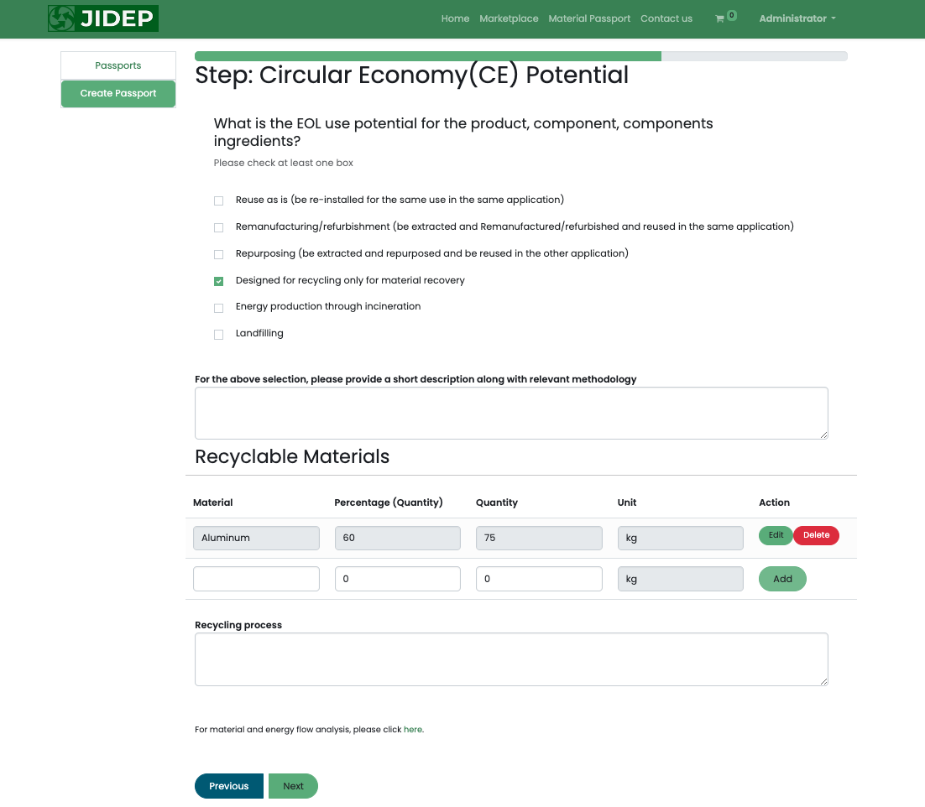
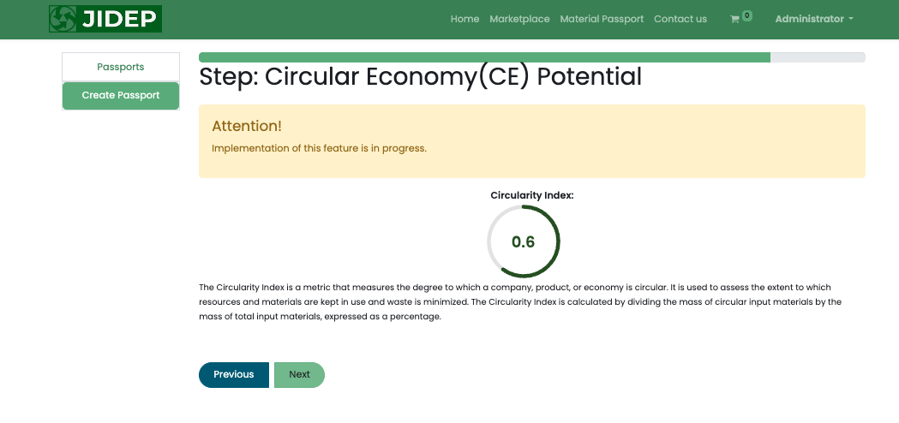
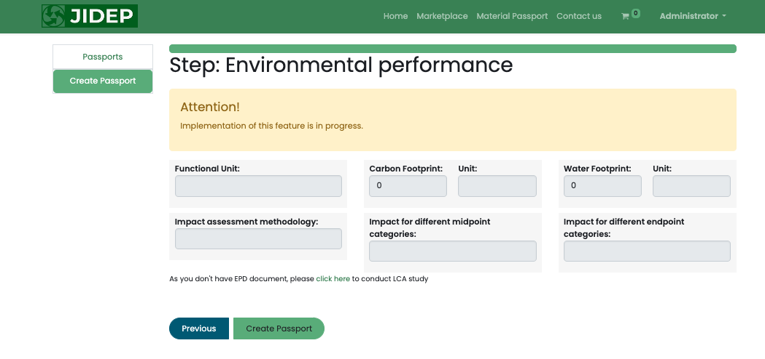
Create Material Passport​
Create Material Passport

Slide 11
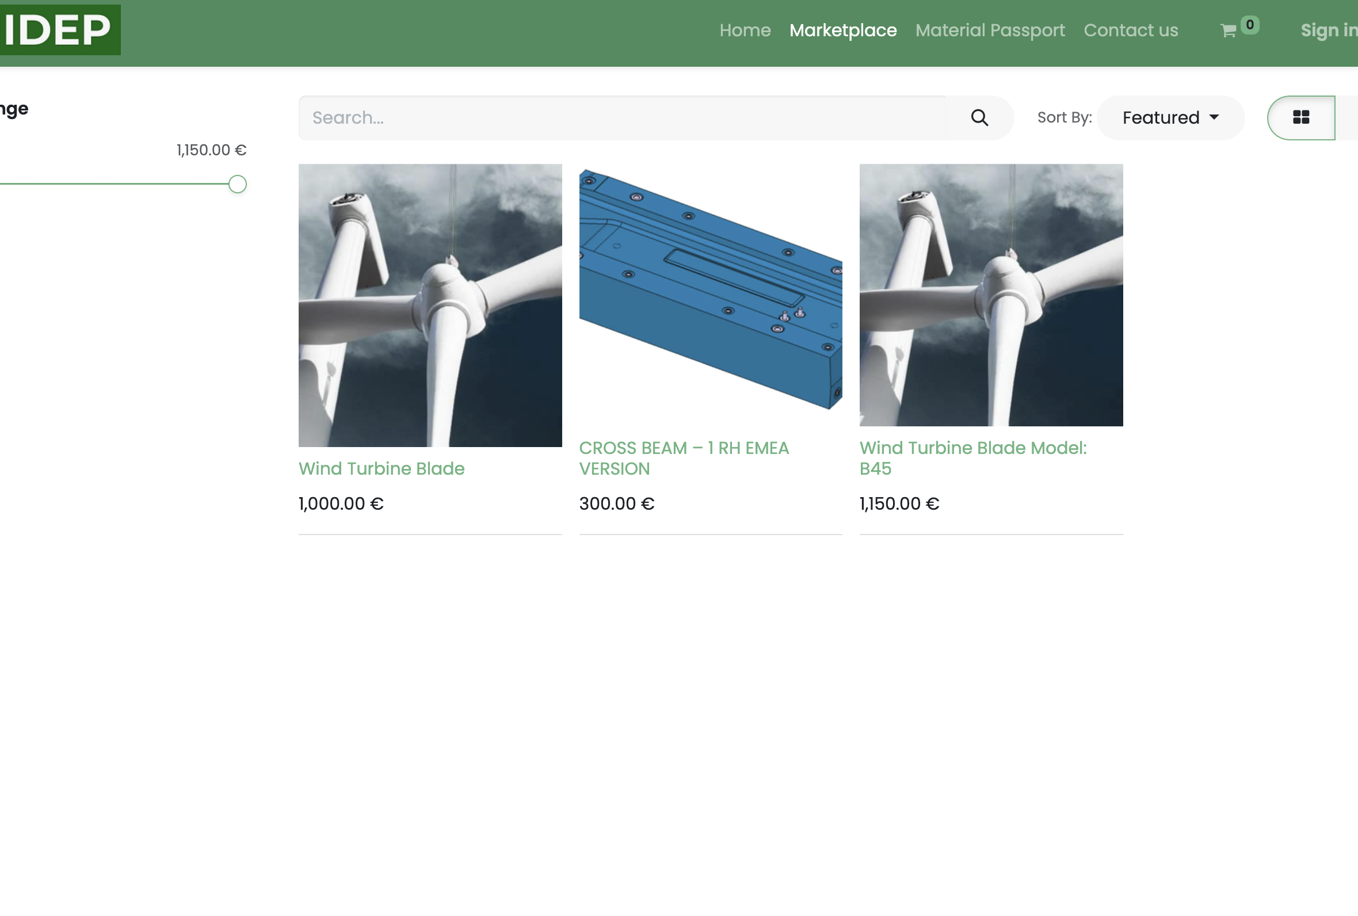
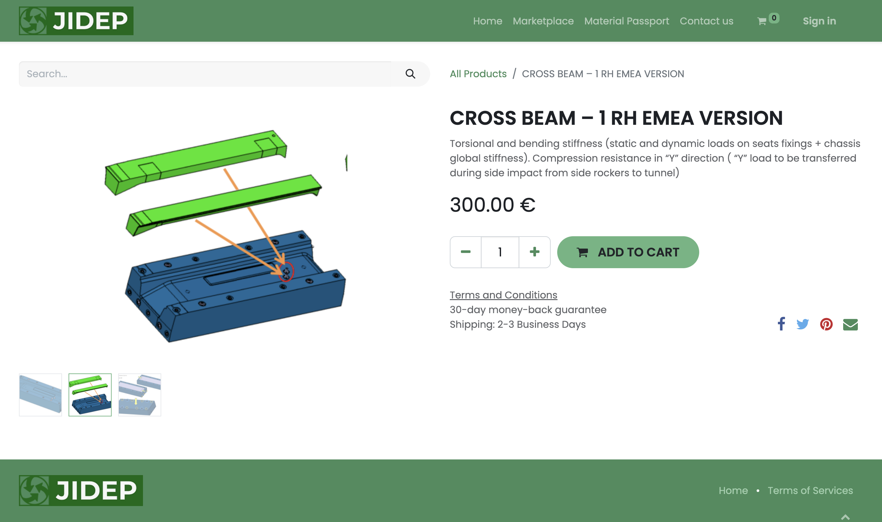
Platform Marketplace
Fig3: JIDEP Platform Product Page
Fig 4: JIDEP Platform Marketplace

Slide 12
Organization (to be Inserted)
Contact (to be inserted)

