Slide 1
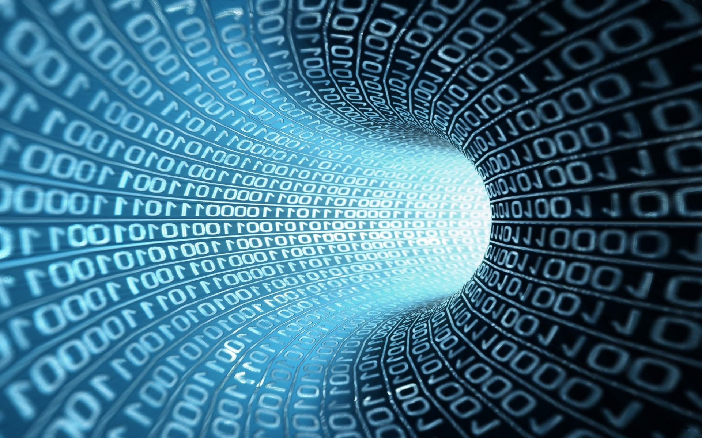

Module 5: Transport logistics
[Name of the presenter]
[Date & Location]

Slide 2
Agenda
Definition Transport Logistics
Difference between Intralogistics and Extralogistics
Business Transformations

Slide 3
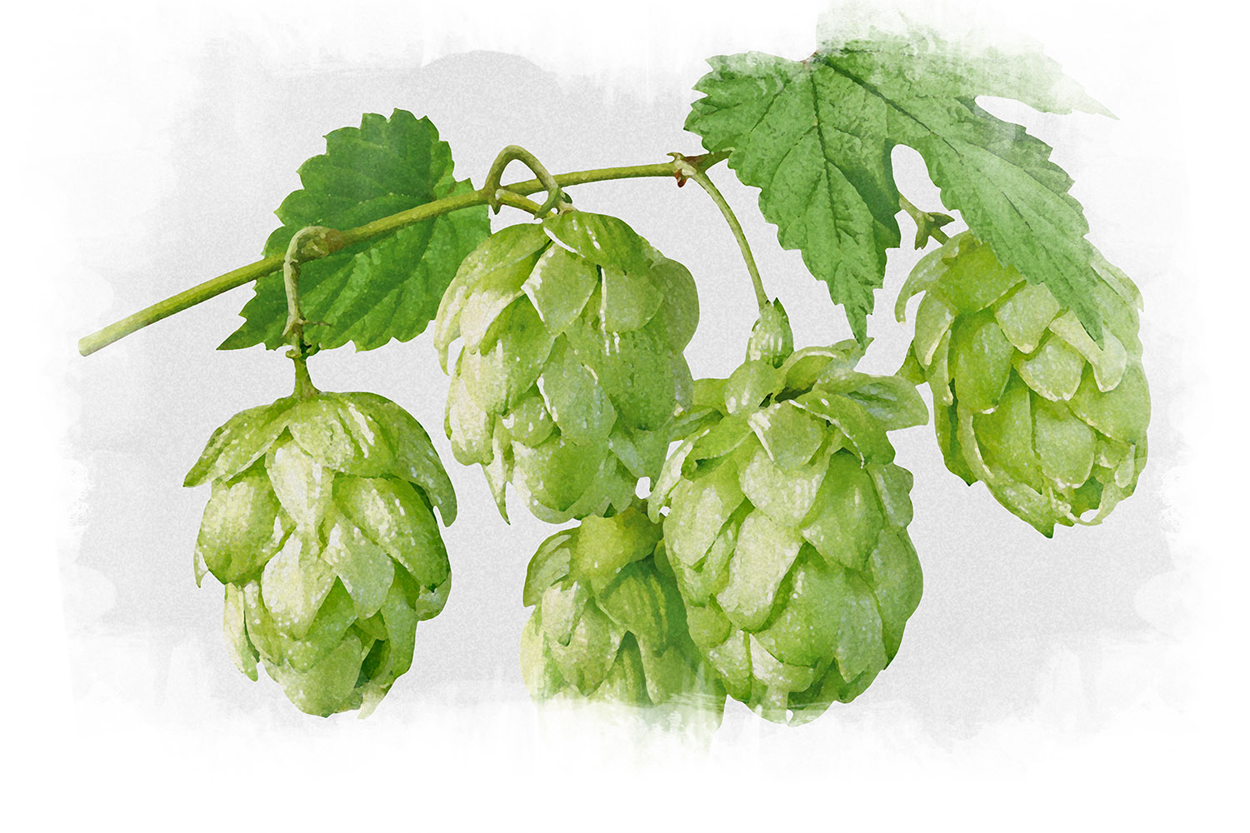
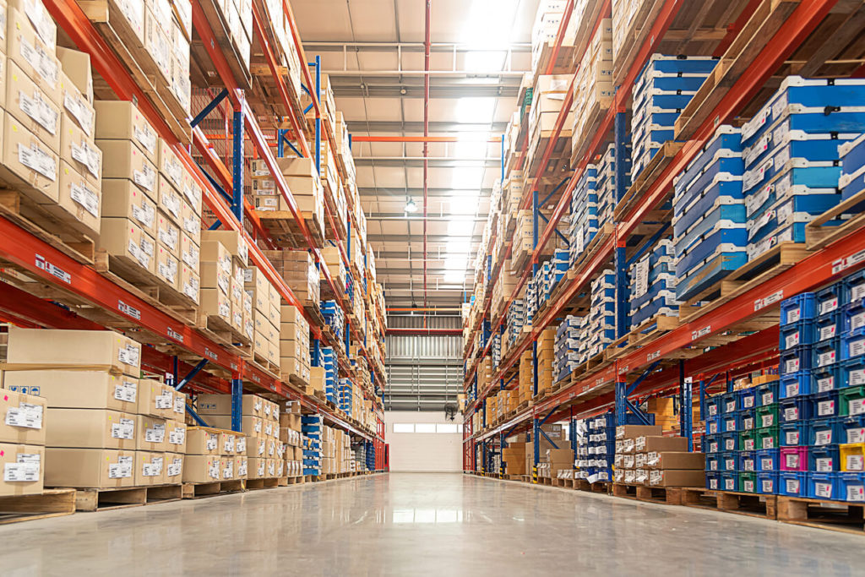
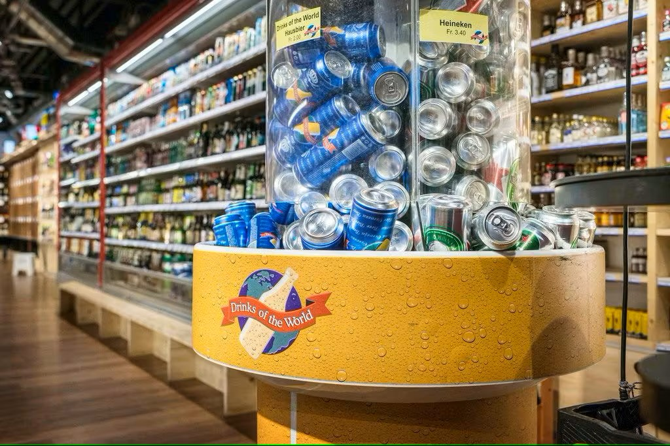
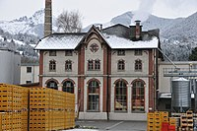
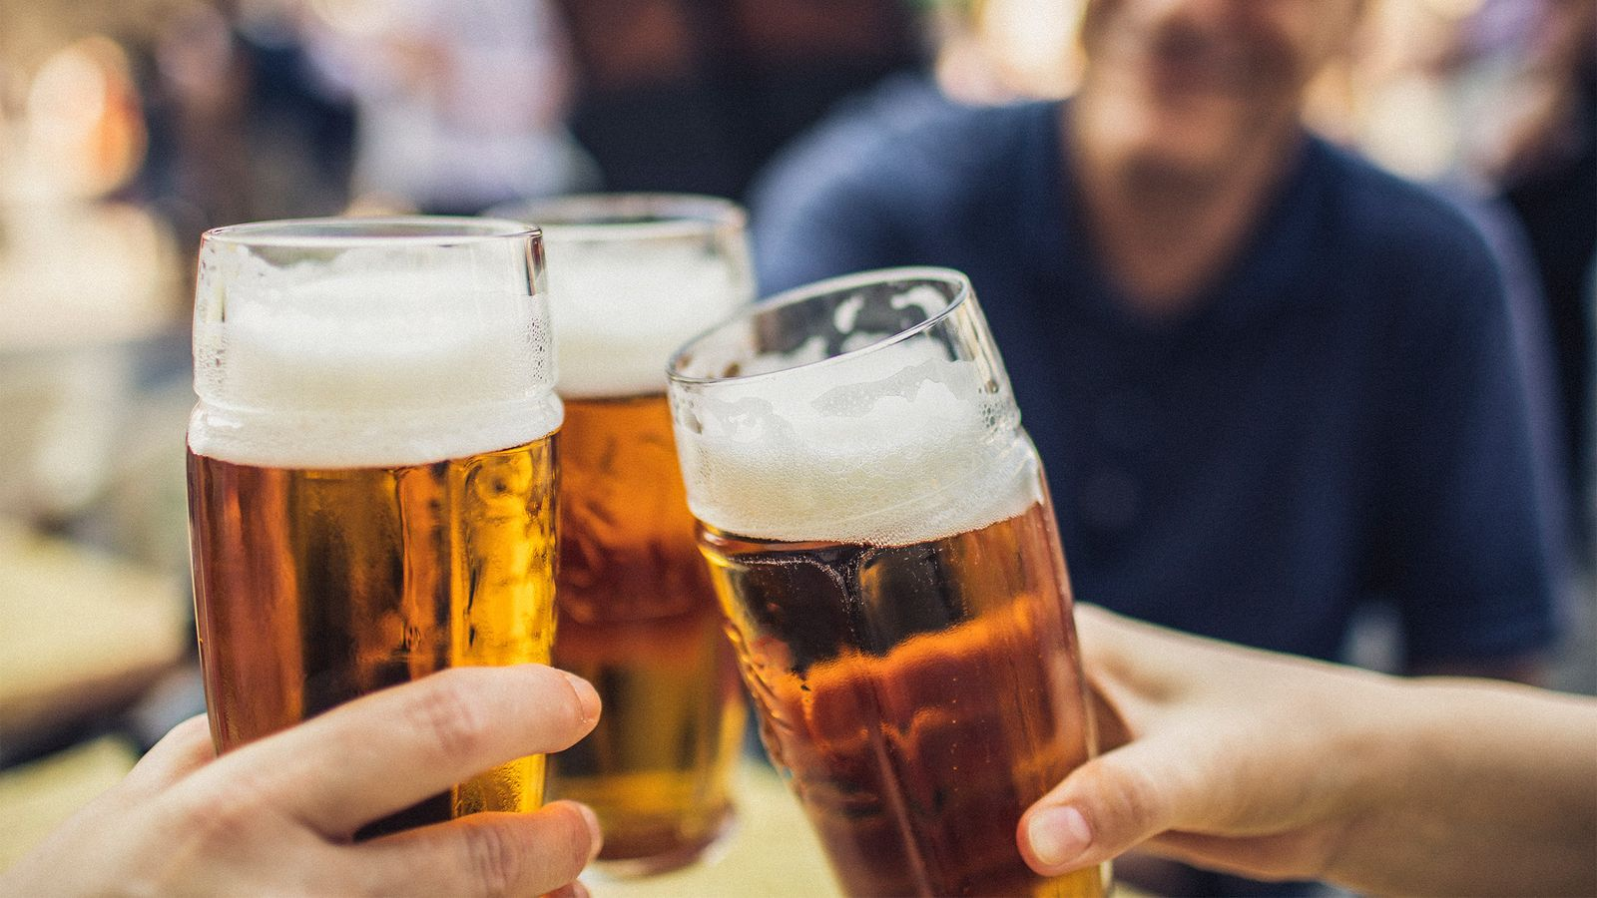
Transport Logistics
Connecting the Supply Chain: Transport includes the physical movement of goods (raw materials, semi-finished materials, finished materials) from one point in the supply chain to the next point. Target point: customer. What is the customer?
Internal
External
Raw material / Supplier
Brewery
Wholesaler
Retailer
Customer
Typical representation

Slide 4
Transport Logistics
Internal/Intra logistics: the movement of goods and the performance of support activities within the company; it encompasses functions as a warehouse/distribution centre, the optimization, and management of the flow of information and supplies: to optimize their delivery times (by use of advanced technologies: automated cargo, robots, Big Data, ERP)
External/Extra logistics: the movement of goods and the performance of support activities within the supply chain networks (supplier → customer); 3PL by using of different means of transport: Air, Rail, Road (Trucks, Intermodal), Sea, Inland water way, Pipeline

Slide 5
Business Transformations
From supplier-centric SC’s to customer-centric SC’s: higher level of customer responsiveness
From push to pull: nothing is made, sourced or moved until there is a demand for it
From inventory to information: demand-driven SC’s (occurs at the end of the SC)
From transactions to relationships: customer retention
From “trucks and shed” to “end-to-end” pipeline management: time – with a special focus on in-bound logistics
From functions to processes: focus on key business processes that create value for customers – cross-functional and market-facing
From stand-alone competition to network rivalry: extended enterprise – a network of specialist providers of resources and competencies that utilize these artifacts

Slide 6
ORGANIZation (to be inserted)
Contact (to be inserted)

