Slide 1


Module 4: Service Designs & Value
Co-Creation
[Name of the presenter]
[Date & Location]

Slide 2
Agenda
Service Science
Service Science – Four Streams
Resilience as a Service
Aim of Service Science

Slide 3
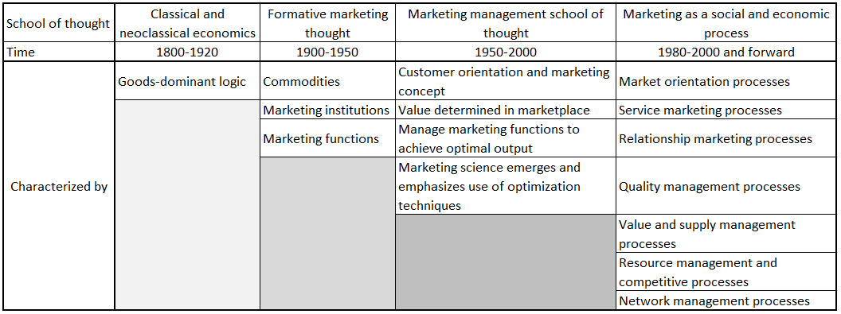
Service Science
… is a reaction to the Good-Dominant Logic (G-D logic). In Goods-Dominant Logic, goods are in the centre of economic exchange. Services in the Goods-Dominant Logic, was all – but ignored. Only over time, services got recognized as “value-adding products” and defined as application of specialized competences for the benefit of others (reciprocal services).

Slide 4
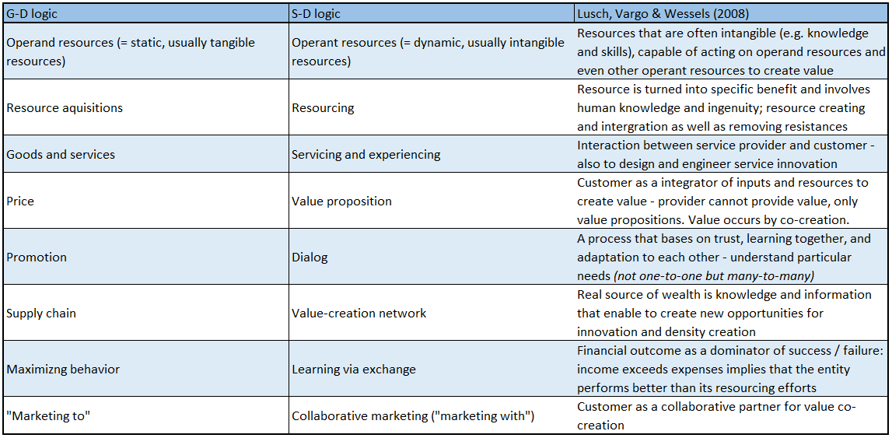
Service Science

Slide 5
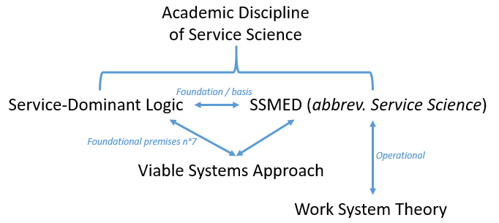
Service Science – four streams
The aim of Service-Dominant Logic is to move forward “ordinary” service management by accelerating the shift from conventional way of thinking to the new way: service can be provided through a good but service is always the common dominator of social and economic exchange. Service are superordinate to goods – not substitutes.
Service Science, Management, Engineering and Design (SSMED, or Service Science) is an operational concept within the general theory of Service Science. “how to improve efficiency evaluation, relations sustainability and systems relations”; “how to develop new technologies, adequate approaches to promote information check, measurement and diffusion”; “how to configuration techniques and studies to correctly structure service systems” (to improve experience and explore possibilities).
The Viable System Approach is a multiple stakeholder concept and aims to build internal and external value creating networks – “configuring the enterprise as an open system”
Work System Theory is an operational concept within the concept of Service Science, Management, Engineering and Design. The Work System Theory provides an ontology about how to engineer, design and innovate service and service systems but also to increase structure and performance of service systems.

Slide 6
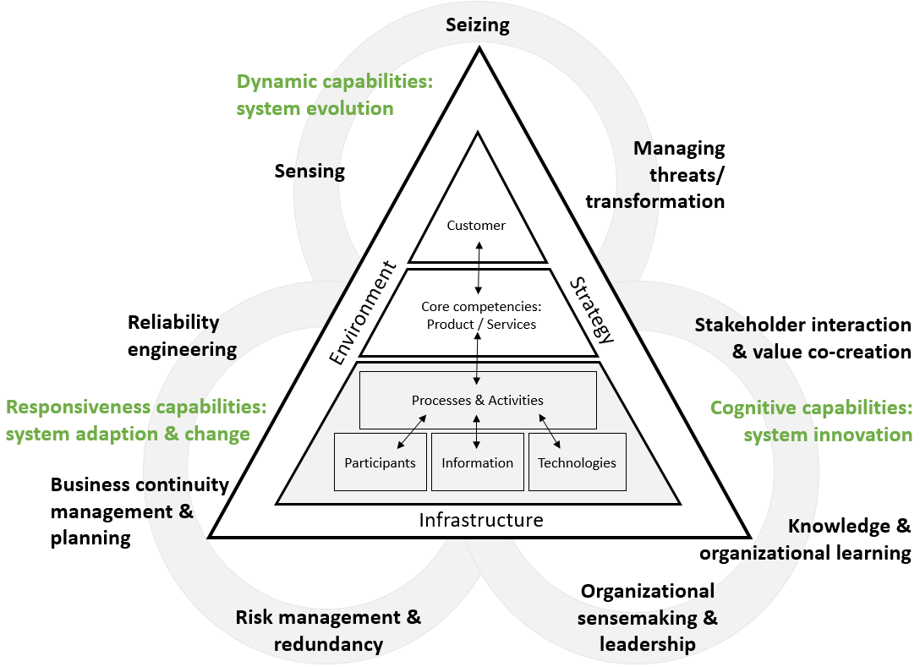
Resilience as a Service
Maurer (2020)

Slide 7
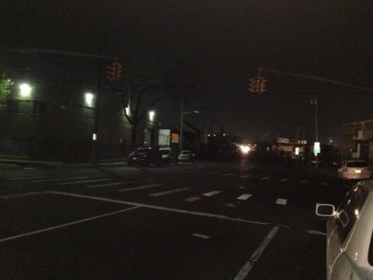

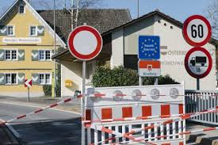
Resilience as a Service
2012
2017
Covid

Slide 8
Resilience as a Service
Maurer (2020)

Slide 9
Aim of Service Science
Service/stakeholder interaction & value co-creation
… facilitate the interaction between the stakeholders; to increase social interaction and value co-creation, collaboration, dynamic interactions (service networks); provider-customer interaction is of special interest; communication/interaction, information sharing, cooperation, collaboration, sophisticated interaction mechanisms, collaborative communication (among multiple service systems: many-to-many) and learning via exchange (e.g. feedback loops), exchange/interaction (to coordinate/orchestrate external needs/wants with internal possibilities)

Slide 10
Organization (To be Inserted)
Contact (to be inserted)

