Slide 1

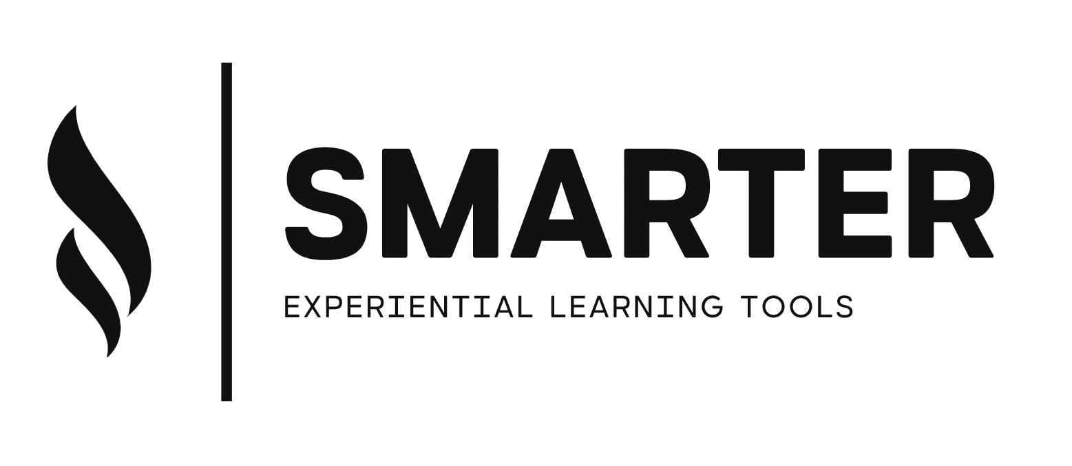
Module 3: Sourcing & Warehousing
[Name of the presenter]
[Date & Location]

Slide 2
Agenda
Warehousing Strategies
Sourcing Strategies
Procurement Strategies
Example Zara

Slide 3
Warehousing
Which kind of warehousing strategies do you know?
FIFO – First in, first out
(i.e., food, medical goods, cosmetics … goods with expiry date)
LIFO – Last in, first out
(i.e., building material, ceramics, glas … non-perishable goods without expiry date)
KIFO – Concern intern, first out
(i.e., Heron … subsidies supplying the mother company)
HIFO – Highest in, first out &
LOFO – Lowest in, first out
(price-depended warehousing; i.e., raw materials)
FEFO – First expired, first out
(goods with urgent expiry date …)
ABC Analysis
Just-in-Time

Slide 4
Sourcing
Which kind of sourcing strategies do you know?
Single sourcing: supply from one procurement source. The required material is procured exclusively from one supplier.
Multiple sourcing: two or more suppliers are selected for a procurement requirement (redundancy!!)
Global sourcing: systematic expansion of the procurement policy to international sources. The opportunities are: cost reduction, sales/turnover increase and risk reduction potential.
Local sourcing
Modular Sourcing: division of labor along the value chain; procurement of complete modules and assemblies

Slide 5
Procurement Strategies
Which kind of procurement strategies do you know?
Individual procurement: goods are only procured when there is a need for them; positive effects on → capital commitment costs, interest costs, warehousing costs
Stock procurement: stocks are deliberately held in order to secure the production process and make the company independent of suppliers (supplier relationships)
Production-synchronized procurement – Just-in-Time: to produce as accurately as possible to demand by simplifying and rationalizing the internal and external material flow within the company and to procure the required material in sync with production. The ideal situation here is stockless production. Decision on →
Inventory minimization, Quality assurance methods, Material flow planning, Selection of means of transportation, Location decisions, Relationship with suppliers

Slide 6
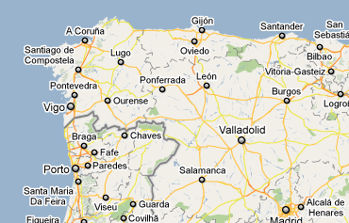

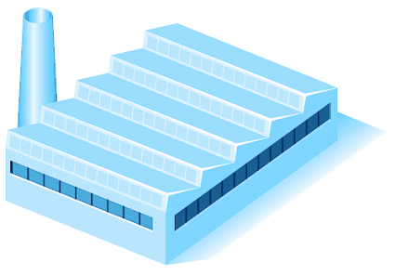

Example ZARA
HQ
20 Factories
High degree of automation;
Technological, logistical support
from Zara
Time-intensive and risky
products are manufactured
in-house
Factories specialized in specific
fabric types (cutting, patterning,
finishing); ~450 mini-factories
(approx. 20 employees),
specialization by fabric type
Price-intensive products outsourced / outsourcing China or the Middle East
~450 small sewing factories

Slide 7
Organization (To be Inserted)
Contact (to be inserted)

