Slide 1


Module 2: Bullwhip Effect
[Name of the presenter]
[Date & Location]

Slide 2
Agenda
Definition Bullwhip Effect
Impact
Strategies to avoid the Bullwhip Effect

Slide 3
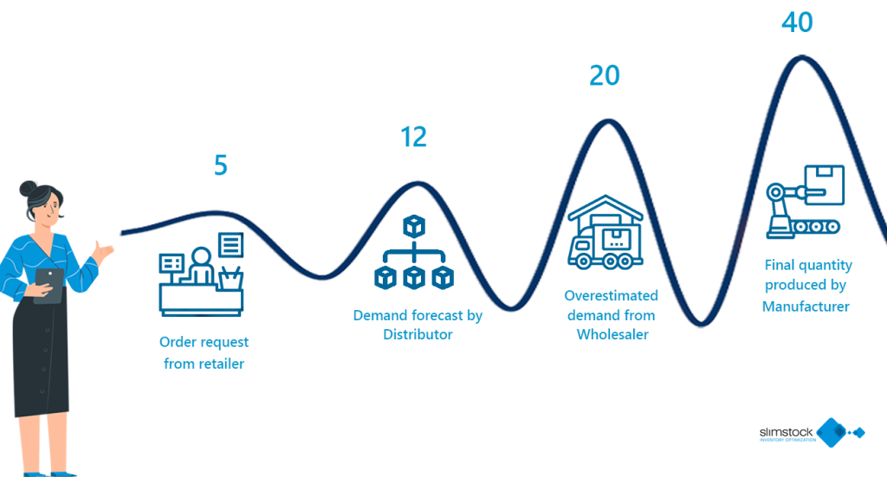
… The what???
Bullwhip effect or whiplash effect or Forrester effect
Phenomenon explored in Forrester (1960): the starting point of the investigations is that in a simple production and distribution system, small disruptions or fluctuations in demand at the retail level often appear to lead to much greater fluctuations in the system. These fluctuations were often regarded as unavoidable, as they were attributed to factors that were said to lie outside the sphere of influence of the respective company.
Past tense: before Forrester (1960)

Slide 4
… The what: The Bullwhip effect
Bullwhip effect or whiplash effect or Forrester effect
… is a phenomenon in which goods do not flow through the supply chain at the level actually required
… caused because of dynamic processes in a supply chain (i.e., customer demand and processing of demand signals → estimates instead of actual figures, safety measures); missing or low coordination; time and order bundling; bottleneck poker (i.e., speculation); price fluctuations; conflicting goals and objectives; individual profit maximization;

Slide 5
Impact
The bullwhip effect has impacts on
Production costs (decrease of production costs through fluctuating orders and purchase orders)
Inventory costs (high stock levels)
Replacement time, recovery time
Transportation costs (because of additional transportation capacities)
Labor costs (distribution, receiving goods)
Shortages
Emotional, psychological factors: relationship, trust, reputation

Slide 6
Strategies to avoid the Bullwhip effect
Examples:
Information exchange & (digital) communication: In most cases, a lack of information flow between the SC stakeholders leads to the bullwhip effect. Countermeasures are therefore aimed at improving the exchange of information. i.e., Collaborative Planning, Forecasting and Replenishment (CPFR) – data directly coming from the points of sale.
Logistics concepts: mixed pallets – different products on one pallet
Pricing strategies
Vendor managed inventory: the supplier takes care of the customer's stock
Supply chain coordination: common goals and objectives (total profit); common measures at all levels of a SC

Slide 7
Organization (To be inserted)
Contact (to be inserted)

