Slide 1


Module 1: Intro Supply Chain Management & Logistics
[Name of the presenter]
[Date & Location]

Slide 2
Agenda
Definition Supply Chain Management & Supply Chain Stakeholders
Development Stage
Supply Chain Network
Flows in a Supply Chain
Process-Oriented Perspective – The Four Cycles

Slide 3

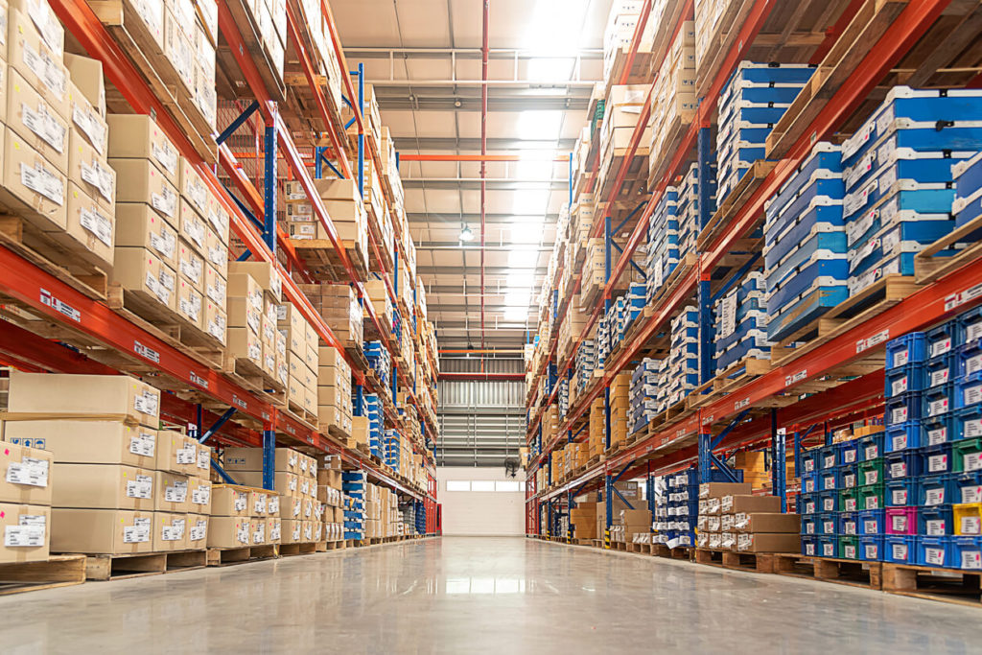
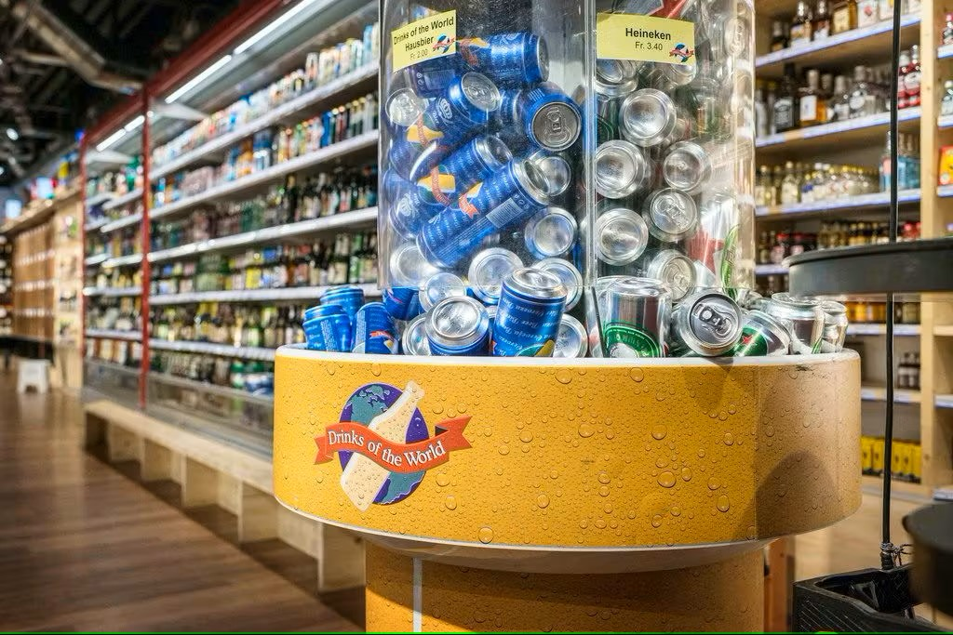
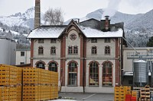

Supply Chain Management?
What is a supply chain?
A supply chain consist of parties that are directly or indirectly involved in the manufacturing/production of a good for the end customer. These are, of course, manufacturers and its suppliers, but also transport service providers, warehouse operators, retailers
… and *important* customers.
Flow of goods; refinement of goods; transportation, warehousing, distribution of goods;
Discussion: who are the involved parties in the production and distribution of a beer?
Not mentioned, i.e.
Raw material / Supplier
Brewery
Wholesaler
Retailer
Customer
Transportation
Warehousing
Customs
Typical representation
Recycling
…

Slide 4
Supply Chain Management?
Process-orientation: development stage of supply chain management
Phase 1: demand-oriented availability of materials and goods
Phase 2: flow-oriented approach of material and goods in a company
Phase 3: logistics from a corporate function to a management function;
flow-oriented organization of internal structures and processes
Phase 4: cross-company flows of goods, information and financial flows of the company to other companies
Phase 4: cross-company flows of goods, information and financial flows of the company to other companies
Phase 3: logistics from a corporate function to a management function;
flow-oriented organization of internal structures and processes
Degree of the flow orientation
Phase 2: flow-oriented approach of material and goods in a company
Phase 1: demand-oriented availability of materials and goods
t (Time)

Slide 5
Supply Chain Management?
What is a supply chain network?
Raw material / Supplier
Brewery
Wholesaler
Retailer
Customer
Raw material / Supplier
Brewery
Wholesaler
Retailer
Customer
Raw material / Supplier
Brewery
Wholesaler
Retailer
Customer

Slide 6
Supply Chain Management?
Flows in a supply chain?
Material flow: the movement of goods and materials from the supplier to the customer.
Finance flow: movement of funds.
Information flow: the sharing and processing of information related to the material flow and finance flow.
Information flow
Material/ Goods flow
Material/ Goods flow
Supplier
Manufacturer
Customer
Finance flow

Slide 7
Supply Chain Management?
Process-oriented perspective – four cycles
Customer-order cycle
Procurement cycle
Production cycle
Distribution cycle
Supplier markets the product
Buyer returns
i.e.
Buyer places order
Buyer receives delivery
Supplier receives the order
Supplier delivers the order

Slide 8
OrGANIZATION (TO BE inserted)
Contact (to be inserted)

